Slide 1


National Source Tracking System (NSTS)
Release 2.0.1
Scenarios/User Guide Sections
Prepared by:
Lockheed Martin

Slide 2
Table of Contents
Title | Page
Section 1: Release 2.0.1 Summary | 3
Section 2: Functionality by User Group | 6
Licensee | 7
Agency | 8
Admin | 9
Section 3: Scenarios | 19

Slide 3
NSTS 2.0.1 Summary
The release of NSTS 2.0.1 includes 31 functionality enhancements designed to broaden the system capabilities in relation to national source tracking. The release features new functionality designed to:
Enhance transfer management
Support the long-term storage of sources
Support the recording of import/export notifications
Support the recording of lost, stolen, found , and irretrievable sources
Enhance query capabilities
Provide alert functionality
Provide reporting functionality
Provide user resources with enhanced help functionality
Enhance administrative features to support alerts, reports, license relationship, and vicinity functions
The Scenarios in the following pages detail each function by user group. In addition detailed user guide excerpts are included for each function in Section three of this document.

Slide 4
NSTS 2.0.1 Summary
Enhanced Transfer Management
Long Term-Storage Functionality
Import/Export Notification Functionality
Record
Update
Review
Lost/Stolen Sources Functionality
Record
Review
Record Found
Record Irretrievable
Review Pending Transfers
Review Transfer History
View Transfer Progress
Review Source History
Specify Sources
Review Sources

Slide 5
NSTS 2.0.1 Summary
Current Alerts
Update Status
Review History
Reports Functionality
Manage Reports
Maintain Report Schedules
Admin Functionality
Maintain Vicinity
Maintain Licensee Relationship
Maintain Alert Rules
Upload Report
Send Message to NSTS Mailbox
Update Message in NSTS Mailbox
New Query Capabilities
Query Source
Query Licenses
Query Transfers/Receipts
Alert Functionality

Slide 6
Section 2: Functionality/Enhancements by User Group
Licensee
  Source User
  Source Manufacturer
  Source Distributor
  Source Disposer
  Source Waste Broker
Licensing Agency
  Department of Energy (DOE)
  Agreement State (A/S) Staff
  NRC Staff
Administration
  NSTS Analyst
  NSTS Administrator

Slide 7
Scenarios
Scenarios describe the behavior of the system from the viewpoint of the users that interact with the system. Graphical “stick” diagrams depict the interaction between the user and the functional process. e.g., “Review Transfer History” The scenarios for the NSTS functions are outlined below and are organized by User Type. Each scenario also has page numbers indicating the location of each scenario for quick reference.
 | Licensee Scenarios | Source User | Distributor | Waste Broker | Disposer | Manufacturer | Page
3.1 | Review Transfer History | ü | ü | ü | ü | ü | 20
3.2 | View Transfer Progress | ü | ü | ü | ü | ü | 22
3.3 | Specify Long-Term Storage Sources | ü | ü | ü |  | ü | 25
3.4 | Current Alerts | ü | ü | ü | ü | ü | 29
3.5 | Send Message to NSTS Mailbox | ü | ü | ü | ü | ü | 35
3.6 | Obtain Supporting Information | ü | ü | ü | ü | ü | 37

Slide 8
 | Licensing Agency Scenarios | DOE | NRC | A/S Staff | Page
3.7 | Query Licenses | ü | ü | ü | 39
3.8 | Query Sources | ü | ü | ü | 43
3.9 | Record Lost or Stolen Sources | ü | ü | ü | 46
3.10 | Review Lost or Stolen Sources | ü | ü | ü | 51
3.11 | Record Found Sources | ü | ü | ü | 54
3.12 | Record Irretrievable Sources | ü | ü | ü | 58
3.13 | Review Source History | ü | ü | ü | 63
3.14 | Query Transfers Receipts | ü | ü | ü | 68
3.15 | Review Pending Transfers | ü | ü | ü | 72
3.16 | Record Import Notifications |  | ü | ü | 76
3.17 | Update Import Notifications |  | ü | ü | 84
3.18 | Record Export Notifications |  | ü | ü | 89
3.19 | Update Export Notifications |  | ü | ü | 98
3.20 | Review Import Notifications | ü | ü | ü | 103
3.21 | Review Export Notifications | ü | ü | ü | 107
3.22 | Manage Reports | ü | ü | ü | 111
3.23 | Maintain Reports Schedules | ü | ü | ü | 129
3.24 | Update Alert Status | ü | ü | ü | 143
3.25 | Review Alert History | ü | ü | ü | 151
3.26 | Review Long-Term Storage Sources | ü | ü | ü | 158
3.1 | Review Transfer History | ü | ü | ü | 20
3.2 | View Transfer Progress | ü | ü | ü | 22
3.3 | Specify Long-Term Storage Sources |  | ü | ü | 25
3.4 | Current Alerts | ü | ü | ü | 29
3.5 | Send Message to NSTS Mailbox | ü | ü | ü | 35
3.6 | Obtain Supporting Information | ü | ü | ü | 37

Slide 9
 | Administrator Scenarios | NSTS Analyst | NSTS Admin | Page
3.27 | Maintain Vicinity |  | ü | 161
3.28 | Maintain Licensee Relationship |  | ü | 169
3.29 | Maintain Alert Rules |  | ü | 175
3.30 | Upload Report | ü |  | 182
3.31 | Update Message to NSTS Mailbox | ü | ü | 186
3.1 | Review Transfer History | ü |  | 20
3.2 | View Transfer Progress | ü |  | 22
3.3 | Specify Long-Term Storage Sources | ü |  | 25
3.4 | Current Alerts | ü |  | 29
3.5 | Send Message to NSTS Mailbox | ü |  | 35
3.6 | Obtain Supporting Information | ü |  | 37
3.7 | Query Licenses | ü |  | 39
3.8 | Query Sources | ü |  | 43
3.9 | Record Lost or Stolen Sources | ü |  | 46
3.10 | Review Lost or Stolen Sources | ü |  | 51
3.11 | Record Found Sources | ü |  | 54
3.12 | Record Irretrievable Sources | ü |  | 58
3.13 | Review Source History | ü |  | 63
3.14 | Query Transfers Receipts | ü |  | 68
3.15 | Review Pending Transfers | ü |  | 72
3.16 | Record Import Notifications | ü |  | 76
3.17 | Update Import Notifications | ü |  | 84
3.18 | Record Export Notifications | ü |  | 89
3.19 | Update Export Notifications | ü |  | 98

Slide 10
 | Administrator Scenarios | NSTS Analyst | NSTS Administrator | Page
3.20 | Review Import Notifications | ü |  | 103
3.21 | Review Export Notifications | ü |  | 107
3.22 | Manage Reports | ü |  | 111
3.23 | Maintain Reports Schedules | ü |  | 129
3.24 | Update Alert Status | ü |  | 143
3.25 | Review Alert History | ü |  | 151
3.26 | Review Long-Term Storage Sources | ü |  | 158

Slide 11
Scenarios – Enhancements/Added Functionality for the Licensee in Release 2.0.1
Source Management
Transfer Management
3.3
Specify Long-Term Storage Sources
3.2
View Transfer Progress
3.1
Review Transfer History
Not for Source Disposer
Alert Management
Licensee
3.4
Current Alerts
Source Waste Broker
Source User
Source Distributor
Training
Source Disposer
3.5
Send Message to NSTS Mailbox
3.6
Obtain Supporting Information

Slide 12
Scenarios – Enhancements/Added Functionality for the Agency in Release 2.0.1
Source Management
3.9
Record Lost or Stolen Sources
3.11
Record Found Sources
3.12
Record Irretrievable Sources
3.10
Review Lost or Stolen Sources
NRC
A/S Staff
DOE
3.26
Review Long-Term Storage Sources
3.8
Query Sources
Agency User
3.13
Review Source History
3.3
*Specify Long-Term Storage Sources
* Surrogate Operation

Slide 13
Scenarios - Agency
Transfer Management
3.14
Query Transfers Receipts
3.1
Review Transfer History
3.2
View Transfer Progress
3.15
Review Pending Transfers
3.16
Record Import Notification*
3.17
Update Import Notification*
3.18
Record Export Notification*
3.19
Update Export Notification*
3.20
Review Import Notification
Agency User
3.21
Review Export Notification
NRC
A/S Staff
DOE
* Not for DOE

Slide 14
Scenarios - Agency
License Management
Report Management
3.7
Query Licenses
3.22
Manage Reports
3.23
Maintain Report Schedules
Alert Management
Training
3.4
Current Alerts
3.24
Update Alert Status
3.6
Obtain Supporting Information
3.25
Review Alert History
3.5
Send Message to NSTS Mailbox
NRC
A/S Staff
DOE
Agency User

Slide 15
Scenarios - Admin
Source Management
3.9
Record Lost or Stolen Sources
3.11
Record Found Sources
NSTS Analyst
3.12
Record Irretrievable Sources
3.10
Review Lost or Stolen Sources
3.26
Review Long-Term Storage Sources
3.8
Query Sources
Admin User
3.13
Review Source History
3.3
*Specify Long-Term Storage Sources
* Surrogate Operation

Slide 16
Scenarios - Admin
Transfer Management
3.14
Query Transfers Receipts
3.1
Review Transfer History
3.2
View Transfer Progress
3.15
Review Pending Transfers
3.16
Record Import Notification
3.17
Update Import Notification
3.18
Record Export Notification
3.19
Update Export Notification
3.20
Review Import Notification
3.21
Review Export Notification
NSTS Analyst
Admin User

Slide 17
Scenarios - Admin
License Management
Report Management
3.7
Query Licenses
3.22
Manage Reports
3.23
Maintain Report Schedules
3.30
Upload Report
Alert Management
Training
3.4
Current Alerts
3.24
Update Alert Status
3.31
Update Message to NSTS Mailbox
3.6
Obtain Supporting Information
3.25
Review Alert History
3.5
Send Message to NSTS Mailbox
NSTS Analyst
Admin User

Slide 18
Scenarios - Admin
License Management
Licensing Agency Management
3.27
Maintain Vicinity
3.28
Maintain License Relationship
Alert Management
Training
3.29
Maintain Alert Rules
3.4
Current Alerts
3.6
Obtain Supporting Information
3.5
Send Message to NSTS Mailbox
3.31
Update Message in NSTS Mailbox
NSTS Admin
Admin User

Slide 19
Section 3
SCENARIOS

Slide 20
Scenario 3.1
Review Transfer History
The Review Transfer History function in NSTS allows the Licensee, Agency, and Administrator user to view information on domestic and foreign (imports/exports) transfers and receipts sent from or received by a license(e). This feature enables the user to view the details of shipments including shipment type, status, sending date, receipt date, and to whom a shipment was made, or from whom a shipment was received. In addition the user is able to view the details of the sources in the shipment by using the source details link.
Scenario 3.1
I would like to view a history of transfers that I have recently sent
From the NSTS Main Menu, under Transfer Management, click the Review Transfer History link.
For licensees, a list of shipments in which the licensee is either the Sender or Receiver will be automatically displayed.
To view information related to the sources involved in the shipment click the Source Information link. For Imports/Exports click the Notification ID Link.

Slide 21
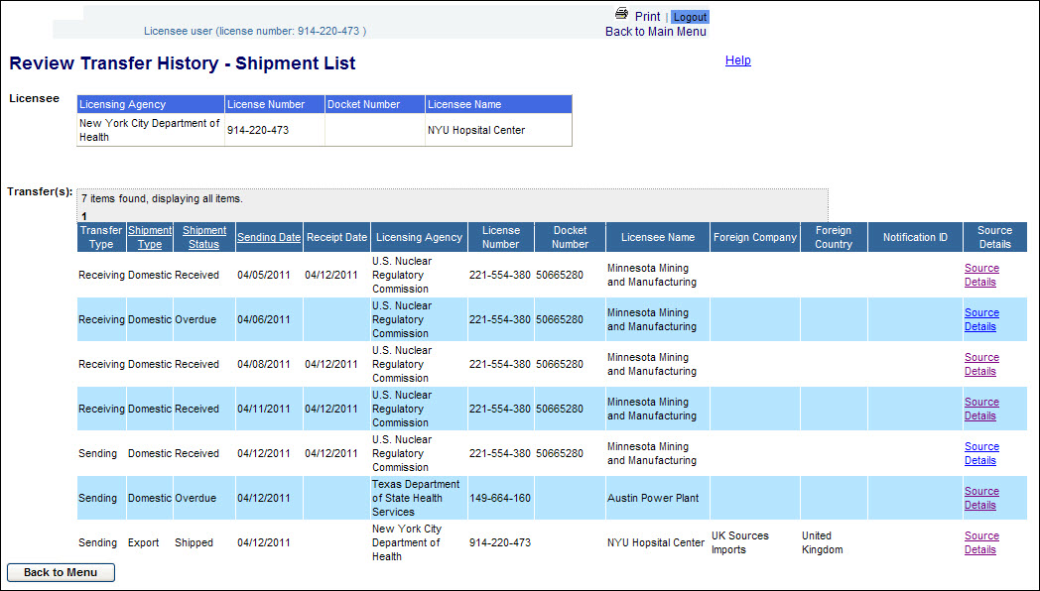
Scenario 3.1
Review Transfer History
To Review Transfer History:
From the NSTS Main Menu, under Transfer Management, click the Review Transfer History link.
For licensees, a list of shipments in which the licensee is either the Sender or Receiver will be automatically displayed
3. To view additional details on the shipment (make, model, serial number, etc. click the source details link. If the shipment is an import/export click the Notification ID link.

Slide 22
Scenario 3.2
View Transfer Progress
The View Transfer Progress function in NSTS allows the Licensee, Agency, and Administrator user to view the status of open shipments in which the licensee is either the Sender or the Receiver .This feature enables the user to view the details of the open shipments including shipment type, status, sending date, estimated arrival date, and to whom or from whom a shipment was made.
Scenario 3.2
I would like to view open shipments where my license is involved in the transaction
From the NSTS Main Menu, under Transfer Management, click the View Transfer Progress link.
For licensees, a list of open shipments in which the licensee is either the Sender or Receiver will be displayed.
From the shipment list, select the radio button of the desired shipment to be viewed and click the Continue button. The View Transfer Progress window will be displayed.

Slide 23
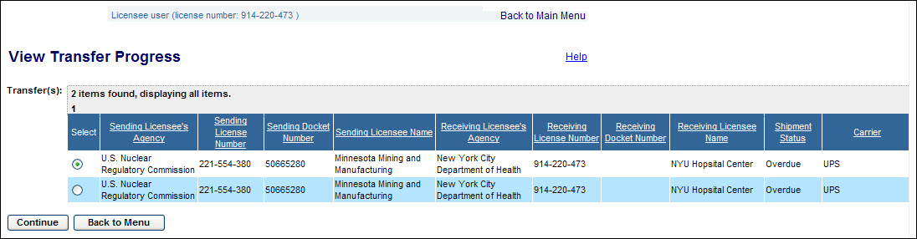
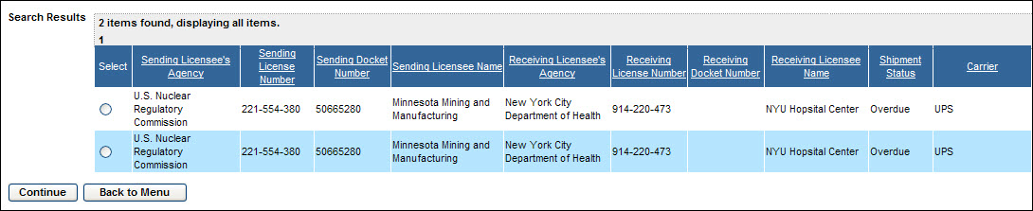
Scenario 3.2
View Transfer Progress
To View Transfer Progress:
From the NSTS Main Menu, under Transfer Management, click the View Transfer Progress link.
  If the user is a licensee, a list of any open shipments in which the licensee is either the Sender or Receiver will be automatically displayed.
  An NRC or Licensing Agency staff user will be presented with the Search and Choose Shipment and Associated Sources search criteria window. The search will return a list of open shipments meeting the criteria entered.
Enter the search criteria and click the Search button. The search results will be displayed below the search criteria box.

Slide 24
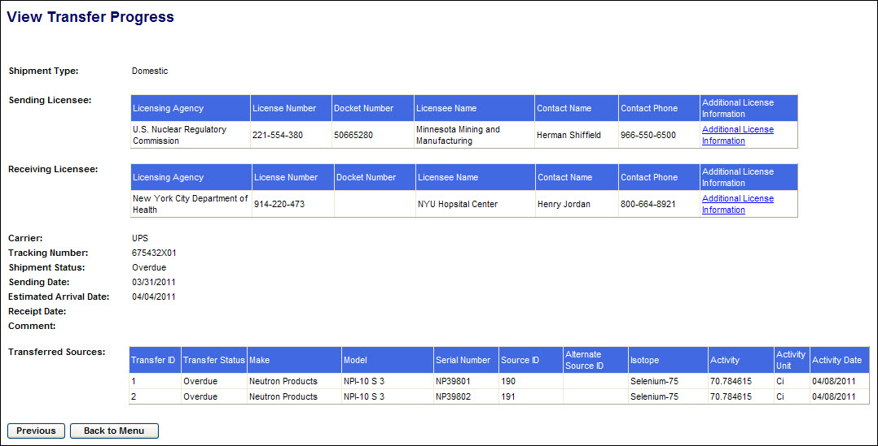
Scenario 3.2
View Transfer Progress
View Transfer Progress Cont.:
From the shipment list, select the radio button for the desired shipment to be viewed and click the Continue button. The View Transfer Progress window will be displayed.
Review the information provided. For more details on either the Sending Licensee or the Receiving Licensee, click the applicable Additional License Information link on the right side of the window.
Click the button to return to the View Transfer Progress window.
From the View Transfer Progress window, click the Back to Menu button to return to the NSTS Main Menu.

Slide 25
Scenario 3.3
Specify Long-Term Storage Sources
The Specify Long-Term Storage Sources function in NSTS allows the Licensee,(Agency, and Administrator users as a surrogate) that has sources which are no longer in use, yet which cannot be disposed of (e.g., Greater Than Class C) to indicate that the source is in long-term storage.
From the NSTS Main Menu, under Source Management, click the Specify Long-Term Storage Sources link.
The Search Sources for Specify Long-Term Storage window will be displayed.
Enter source criteria and click search
From the results select the desired source and click the Specify Long-Term Storage button
Enter the Long-Term Storage Date and Reason and click the save button.
The Specify Long-Term Storage Source Confirmation window will be displayed.
Scenario 3.3
I have sources no longer in use that are not able to be disposed of. How can I update NSTS with this information?

Slide 26
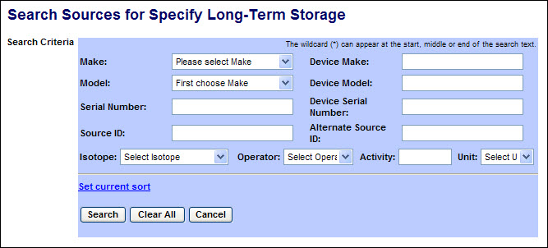
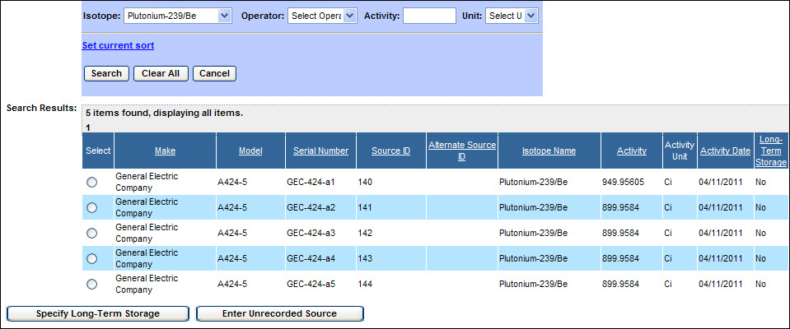
Scenario 3.3
Specify Long-Term Storage Sources
To Specify Long-Term Storage Sources:
From the NSTS Main Menu, under the Source Management, click the Specify Long-Term Storage Sources link. The Search Sources for Specify Long-Term Storage window will be displayed.
Enter search criteria and click the Search button.
A list of sources meeting the search criteria will be displayed. (If no criteria are entered, all trackable sources in the licensee’s inventory will be listed.)

Slide 27
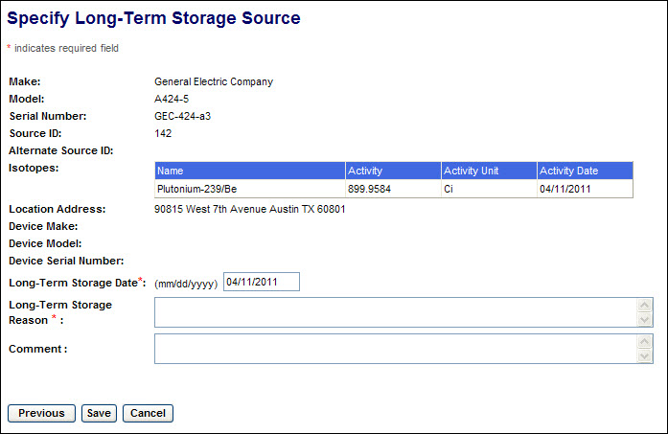
Scenario 3.3
Specify Long-Term Storage Sources
Specify Long-Term Storage Sources cont.:
From the search results displayed, select the radio button for the desired source. Then click the Specify Long-Term Storage button.
The Specify Long-Term Storage Source window will be displayed.
Enter source storage information in the following fields:
Long-Term Storage Date (Required) – Enter the date the source will be or was placed in long-term storage.
Long-Term Storage Reason (Required) – Enter the reason the source was placed in long-term storage, (e.g., Available for reuse).
Comment (Optional) – Although this field is not required, you may enter comments that would be applicable.
After populating the form, click the Save button. The Specify Long-Term Storage Source Confirmation window will be displayed.

Slide 28
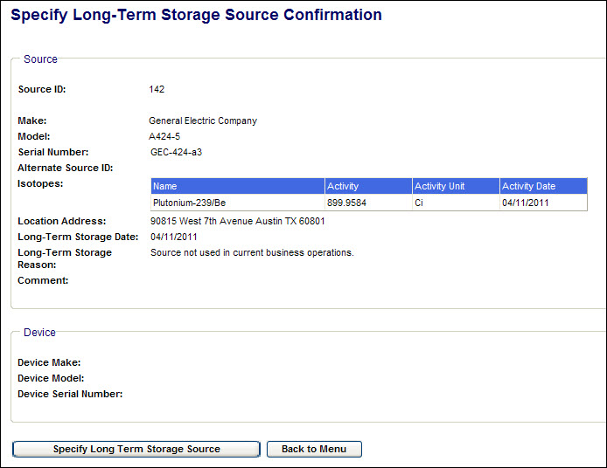
Scenario 3.3
Specify Long-Term Storage Sources
Specify Long-Term Storage Sources cont.:
Click the Specify Long Term Storage Source button to select another source for long-term storage, or click the Back to Menu button to return to the NSTS Main Menu.

Slide 29
Scenario 3.4
Current Alerts
Certain business or system events require the attention of the NRC staff, Agreement State Staff, DOE Staff, and/or Licensees. When such events occur, the system generates an alert, presents it to the user when they login to the system, emails it to the designated alert recipients, and logs the alert. Alerts are generated in response to rules maintained by the system administrator.
Alerts will be generated for such events as the report of a lost or stolen source; an overdue receipt of a source; incomplete recipient of a shipment; and the entry of unrecorded sources, makes/models, and locations.
Scenario 3.4
What Alert options are available in NSTS?
Alert notice at the top of the main menu
View Alert Details
Update Alert Status
You can change the Primary Recipient

Slide 30
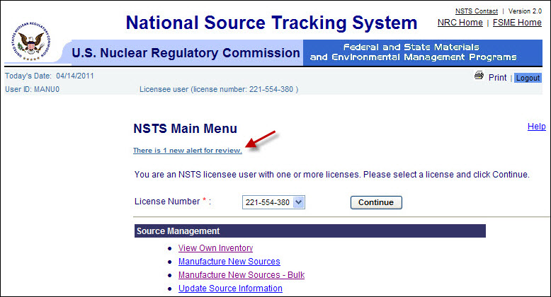
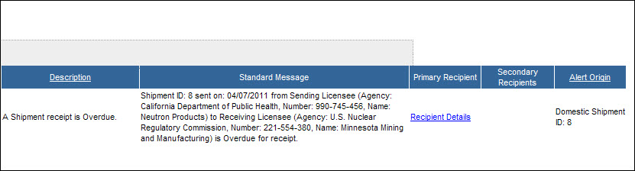
Scenario 3.4
Display Current Alerts
To Display Current Alerts.:
At the top of the Main Menu, a notice of new Alerts in which the user is a recipient will be displayed. Click the link to display the details of the Alert(s).
From the NSTS Main Menu, under Alert Management, click the Current Alerts link. Details of all current Alerts in which the user is a recipient will be displayed.
Click the Recipient Details link under either Primary Recipient or Secondary Recipient to display the name and information about the recipient of the Alert.

Slide 31
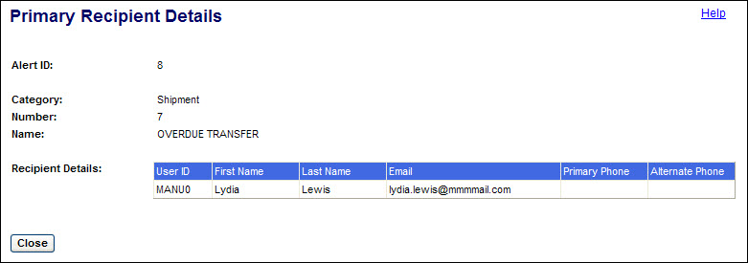
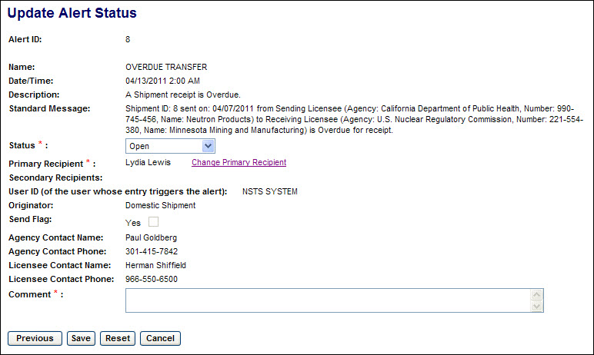
Scenario 3.4
Display Current Alerts
Display Current Alerts Cont.:
Click the Close button to return to the list of Alerts.
To update the status of an Alert, in the list of Alerts select the radio button of the Alert to be updated. Then click the Update Alert Status button. The Update Alert Status window will be displayed.

Slide 32
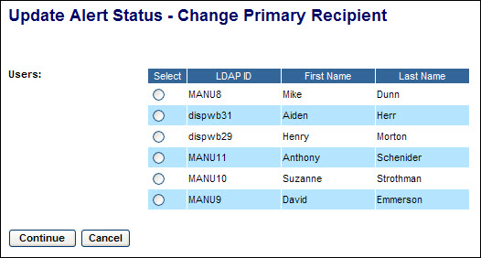
Scenario 3.4
Display Current Alerts
To Display Current Alerts Cont.:
After reviewing the Alert Status History, click the Previous button to return to the list of Alerts or click the Cancel button to return to the NSTS Main Menu.
(See 6. below regarding the Save and Reset buttons.)
A user named as the Primary Recipient and whose role includes Alert Manager for the associated license can update the Alert Status or change the Primary Recipient. Both Primary and Secondary Recipients can add Comments.
To select a new Primary Recipient, click the radio button ( ) for that user. Then click the Continue button. The Update Alert Status window will be displayed.
(Click the Cancel button to return to the Update Alert Status window without making any change.)
Review the changes and add a comment if appropriate. Then click the Save button. The Update Alert Status Confirmation window will be displayed.

Slide 33
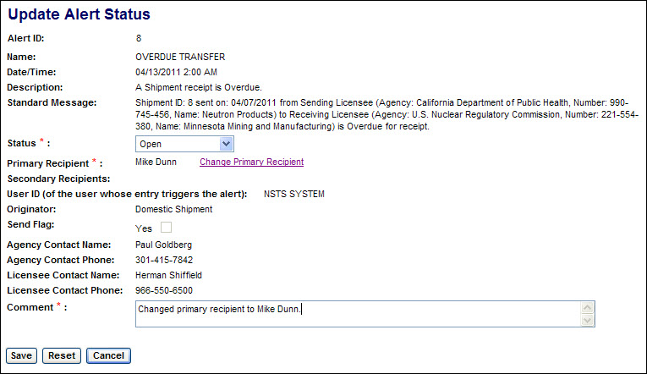
Scenario 3.4
Display Current Alerts
Display Current Alerts Cont.:
If the Primary Recipient is changed, the new recipient will be sent a copy of the Alert
(Prior to saving, you may click the Reset button to undo any changes to the Alert Status or Comments and remain in the Update Alert Status Window. The Reset button will not undo a change of the Primary Recipient.
Click the Cancel button to return to the list of current Alerts without saving any changes (including a change of the Primary Recipient.))
Review the confirmation of changes to the Alert Status

Slide 34
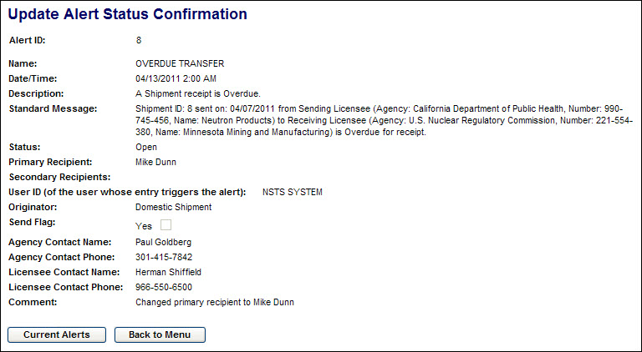
Scenario 3.4
Display Current Alerts
To Display Current Alerts Cont.:
Click the Current Alerts button to return to the list of current Alerts. To return to the Main Menu, click the Back to Menu button

Slide 35
Scenario 3.5
Send Message to NSTS Mailbox
The Send Message to NSTS Mailbox capability enables the Licensee, Agency, and Admin user to send an email message to the NSTS Mailbox within the application.
Scenario 3.5
From the NSTS Main Menu, under Alert Management, click the Send Message to NSTS Mailbox link.
The Send Message to NSTS Mailbox display appears
Fill in the Organization, Email, and if desired phone number field.
Type in the message to be sent to the NSTS Mailbox
Click Send
How can I contact the NSTS Administrator?

Slide 36
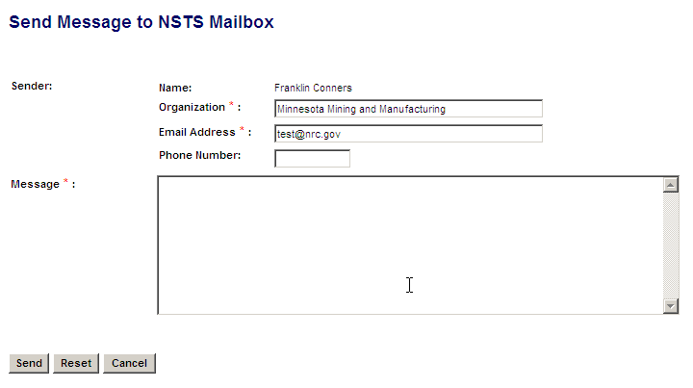
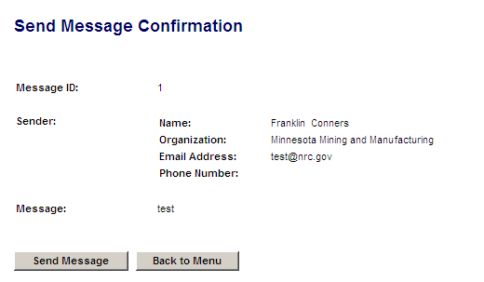
Scenario 3.5
Send Message to NSTS Mailbox
To Send a Message to the NSTS Mailbox.:
From the NSTS Main Menu, under Alert Management, click the Send Message to NSTS Mailbox link.
The Send Message to NSTS Mailbox display appears
Fill in the Organization, Email, and if desired phone number field.
Type in the message to be sent to the NSTS Mailbox
Click the Send button
The Send Message confirmation appears

Slide 37
Scenario 3.6
Obtain Supporting Information
The Obtain Supporting Information capability enables the Licensee, Agency, and Admin user to access a list of reference documents (including other websites) that are related to NSTS
Scenario 3.6
I need some regulation information related to reporting source transfers
From the NSTS Main Menu, under Training, click the Obtain Supporting Information link .
The NSTS Supporting Information page is will display available resource links

Slide 38
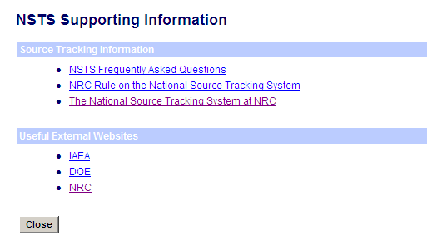
Scenario 3.6
Obtain Supporting Information
To Obtain Supporting Information.:
From the NSTS Main Menu, under Training, click the Obtain Supporting Information link
The NSTS Supporting Information page is displayed
Select the appropriate link from the list of available resources
Click the back button to return to NSTS
Click the close button to return to the main menu

Slide 39
Scenario 3.7
Query Licenses
The Query Licenses functionality enables the Agency, and Admin user to retrieve a list of licenses based on selection of specific criteria. The list can be viewed and saved as either a straight list or formatted as mailing labels. The list of licenses displayed is auto filtered according to user role.
Scenario 3.7
I would like to know how many licensees within my Agency are in possession of Category 1 Co-60 sources.
From the NSTS Main Menu, under License Management, select the Query Licenses link.
Enter Search Criteria
Review Results
Save the information or create mailing labels if desired

Slide 40
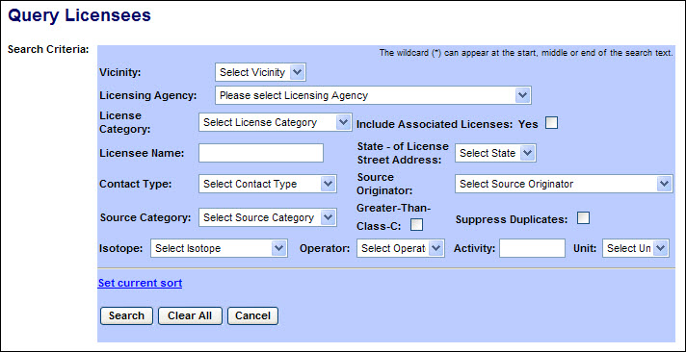
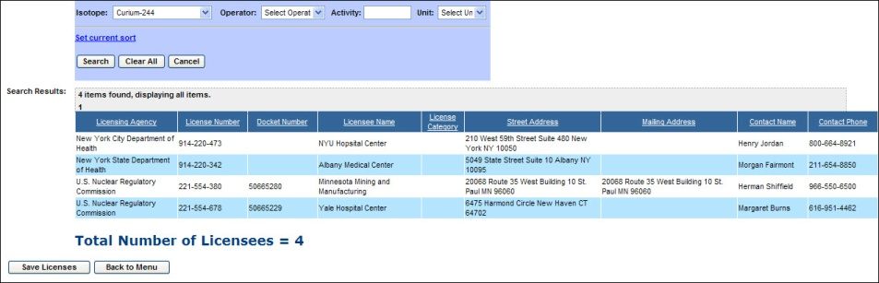
Scenario 3.7
Query Licenses
To Query Licenses:
1. From the NSTS Main Menu, under License Management, select the Query Licenses link. The Query Licenses search criteria window appears:
2. After entering the search criteria, select the Search button. (If no criteria are selected, all licenses which the user is authorized to view will be displayed.)
Scroll to the right to display additional license information.

Slide 41
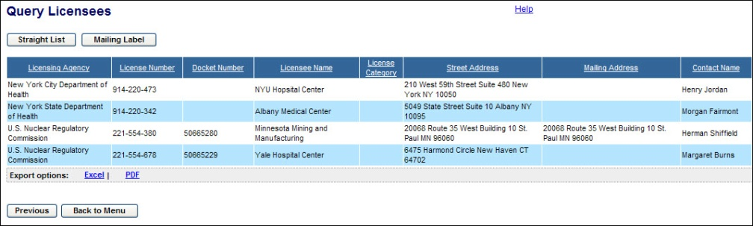
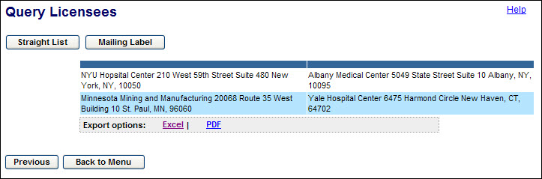
Scenario 3.7
Query Licenses
To Query Licenses Cont.:
3. To view and save the search results as either a straight list or formatted as mailing labels, click the Save Licenses link. The default view is the Straight List.
The Straight List may be saved either as an Excel worksheet or as a PDF file by clicking the links at the bottom of the list.
Note: Click the Previous button to return to the Query Licenses search screen.
To view and save the search results formatted as mailing labels, click the Mailing Labels button.

Slide 42
Scenario 3.7
Query Licenses
Query Licenses Cont.:
The Mailing Labels may be saved either as an Excel worksheet or as a PDF file by clicking the links at the bottom of the list.
After reviewing the information provided, click the Back to Menu button to return to the NSTS Main Menu.

Slide 43
Scenario 3.8
Query Sources
The Query Sources functionality enables the Agency, and Admin user to retrieve a list of sources based on the selection of specific criteria. Only those sources which the user is authorized to view will be displayed
Scenario 3.8
I would like to know how many sources of a specific make and model are in my Agency.
From the NSTS Main Menu, under Source Management, select the Query Sources link.
Enter Search Criteria
Review Results

Slide 44
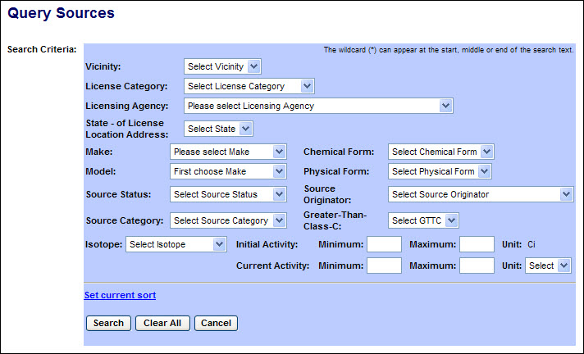
Scenario 3.8
Query Sources
To Query Sources:
1. From the NSTS Main Menu, under Source Management, select the Query Sources link. The Query Sources search criteria window appears:
After entering the search criteria, select the Search button. (If no criteria are selected, all sources which the user is authorized to view will be displayed.)
Scroll to the right to display additional source information.

Slide 45
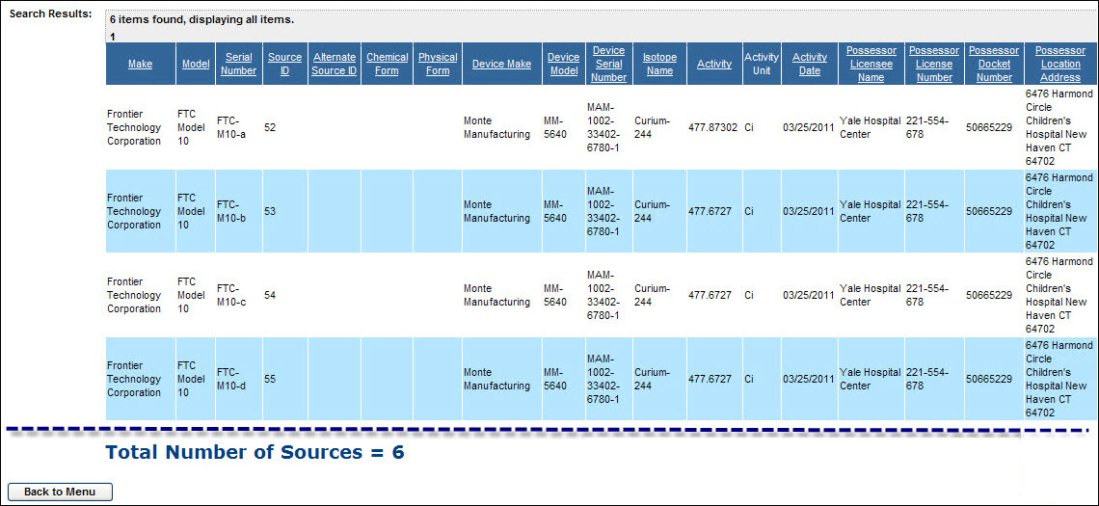
Scenario 3.8
Query Sources
Query Sources Cont.:
After reviewing the information provided, click the Back to Menu button to return to the NSTS Main Menu.

Slide 46
Scenario 3.9
Record Lost or Stolen Sources
A Licensee must report to its respective agency (the NRC, Agreement States, or DOE) when Sources are lost or stolen. The recording of a lost/stolen source in the NSTS is typically done by the NRC Operations Center or the Agreement State / DOE equivalents. The Record Lost or Stolen Sources functionality enables the user to update the status of a source in a licensees inventory to lost or stolen
Scenario 3.9
We have received notification from one of our licensees that a source has been stolen. How do we record this information in NSTS?
From the NSTS Main Menu, under Source Management, select the Record Lost or Stolen Sources link.
Search and Select License
Search and Select Source
Record Lost or Stolen
Enter data for required fields
Save

Slide 47
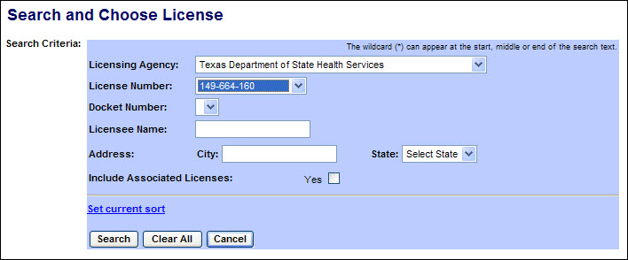
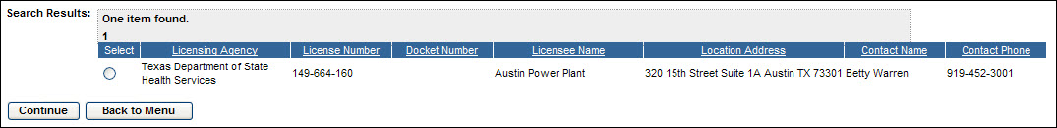
Scenario 3.9
Record Lost or Stolen Sources
To Record Lost or Stolen Sources:
1. From the NSTS Main Menu, under Source Management, select the Record Lost or Stolen Sources link. The Search and Choose License window will be displayed.
Enter the search criteria to display a list of Licenses, and then click Search. A list of licenses meeting the search criteria will be displayed. (If no criteria are entered, all licenses accessible to the user will be listed.)

Slide 48
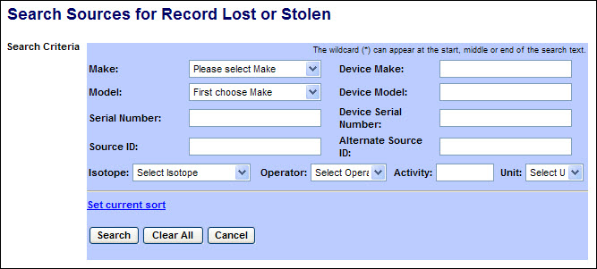
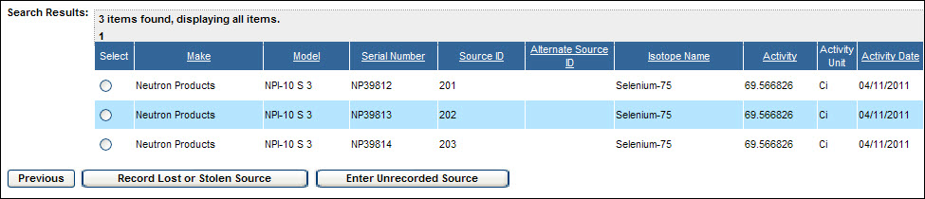
Scenario 3.9
Record Lost or Stolen Sources
Record Lost or Stolen Sources Cont.:
3. Click the radio button ( ) for the applicable Licensee, then click the Continue button. The Search Sources for Record Lost or Stolen search criteria window will be displayed.
Enter the search criteria, and then click Search. A list of sources in the selected licensee’s inventory which meet the search criteria will be displayed. (If no criteria are entered, all sources in the licensee’s inventory will be listed.)

Slide 49
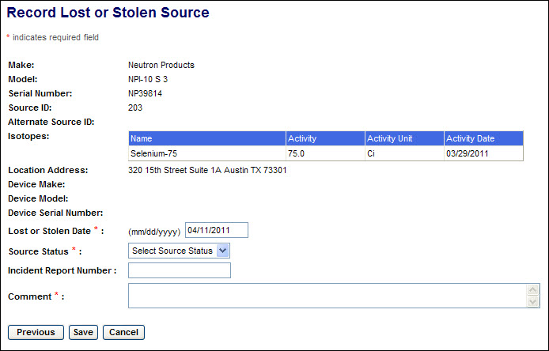
Scenario 3.9
Record Lost or Stolen Sources
Record Lost or Stolen Sources Cont.:
Note: Click the Previous button to return to the Search Sources for Record Lost or Stolen screen.
Click the radio button ( ) for the lost/stolen source, and then click the Record Lost or Stolen Source button. The Record Lost or Stolen Source window appears
Note: Click the Previous button to return to the search results window.

Slide 50
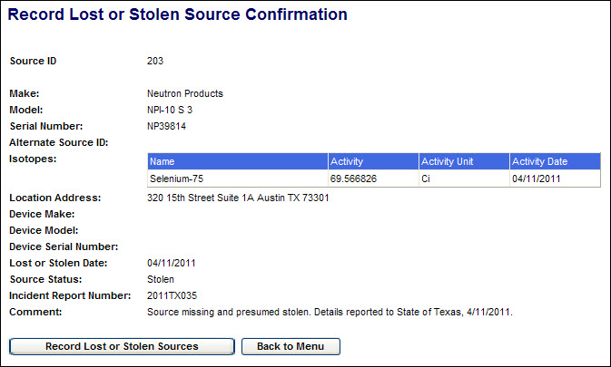
Scenario 3.9
Record Lost or Stolen Sources
Record Lost or Stolen Sources Cont.:
Review the information presented.
Enter the applicable information in the following fields:
Field Name | Req. Value | Description/Comments | Acceptable Values | Example Value
Lost or Stolen Date | Y | Enter date of lost or stolen item. | mm/dd/yyyy | 02/09/2011
Source Status | Y | Use the drop-down arrow to select the appropriate status. | Drop-down | Lost
Incident Report Number | N | Enter the Incident Report Number. | Free-form text | 2011TX035
Comment | Y | Enter comments regarding situation involving the Lost or Stolen Source. | Free-form text
Select the Save button. A confirmation of the report will be displayed.

Slide 51
Scenario 3.10
Review Lost or Stolen Sources
The Record Lost or Stolen Sources functionality enables the Agency, and Admin user to view sources that have been reported as Lost or Stolen
Scenario 3.10
I need to see a listing of all sources that have been reported as lost or stolen in a particular state
Under Source Management, click on the Review Lost/Stolen Sources link
Enter search criteria if desired
Click the Search button

Slide 52
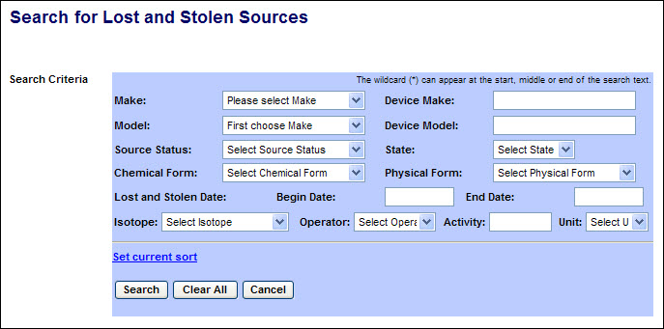
Scenario 3.10
Review Lost or Stolen Sources
Review Lost or Stolen Sources Cont.:
From the NSTS Main Menu, under Source Management, click on the Review Lost/Stolen Sources link. The Search for Lost and Stolen Sources search criteria window appears:
After entering the search criteria, select the Search button. (If no criteria are selected, all sources which the user is authorized to view will be displayed.)

Slide 53
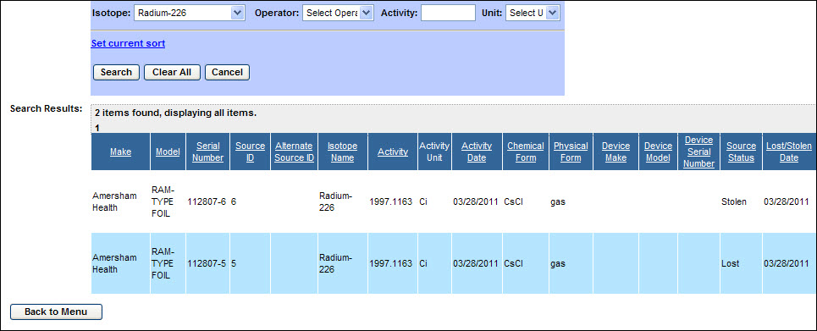
Scenario 3.10
Review Lost or Stolen Sources
Review Lost or Stolen Sources Cont.:
After reviewing the information provided, click the Back to Menu button to return to the NSTS Main Menu.

Slide 54
Scenario 3.11
Record Found Sources
A licensee or member of the public may report finding a source to the NRC, an Agreement State agency, or to the DOE. A report of a found source is typically entered in the NSTS by the NRC operations call center or Agreement State/DOE equivalents. The Record Found Sources functionality enables the user to mark a lost or stolen source as found.
Scenario 3.11
One of our licensees has found a source previously reported as lost. How do I update NSTS with this information?
Under Source Management, click on the Record Found Sources link
Enter search criteria if desired
Select Source
Click the Record Found Source button
Enter required information
Save

Slide 55
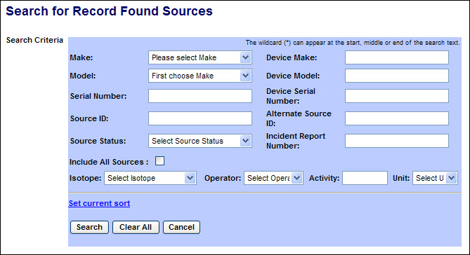
Scenario 3.11
Record Found Sources
To Record Found Sources :
From the NSTS Main Menu, under Source Management, click on the Record Found Sources link. The Search for Record Found Sources search criteria window will be displayed
Enter the search criteria, and then click Search. A list of sources meeting the search criteria will be displayed.
By default, only those sources matching the search criteria and that have been reported lost or stolen will be included in the search results. If the search results should include sources not reported as lost or stolen, select the Include All Sources checkbox. (If no criteria are entered, all sources accessible to the user will be listed.)

Slide 56
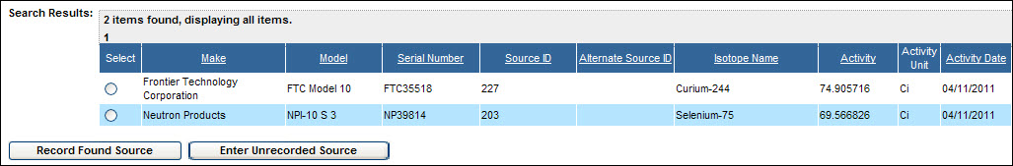
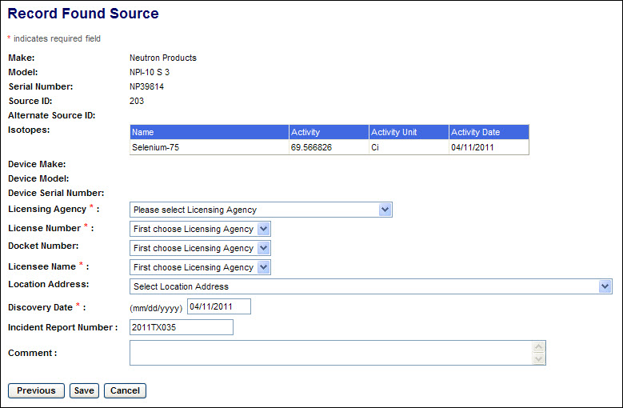
Scenario 3.11
Record Found Sources
Record Found Sources Cont.:
If the found source is included in the search results, click the radio button ( ) for the source and click the Record Found Source button. The Record Found Source window will be displayed.
(If the found source is not included in the search results, click the Enter Unrecorded Source link to record the source. (Refer to User Guide section 4.4.1) After recording the source, repeat the search for found sources with a checkmark in Include All Sources.)

Slide 57
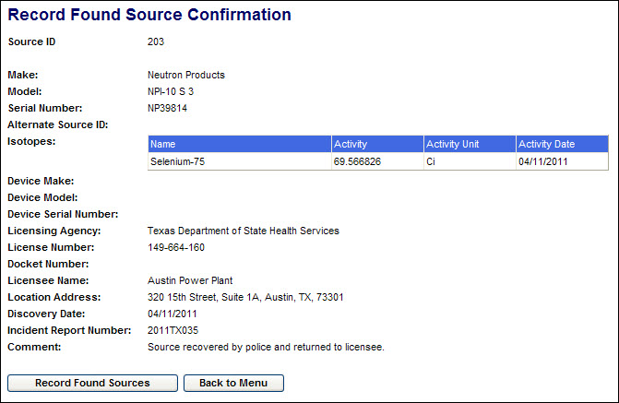
Scenario 3.11
Record Found Sources
Record Found Sources Cont.:
Complete the entry of information describing the date of source discovery and the current custodian licensee of the source. Click the Save button, and the Record Found Source Confirmation screen will be displayed.
Note: Click the Previous button to return to the search results screen.
If the source had not been reported as lost or stolen, an Alert will be generated and sent to designated NRC staff.
On the confirmation screen, click the Back to Menu button to return to the NSTS Main Menu or click the Record Found Source button to record another found source.

Slide 58
Scenario 3.12
Record Irretrievable Sources
A Licensee must report to its licensing agency (the NRC, Agreement State, or DOE) when a Source is irretrievable. The recording of an irretrievable source in the NSTS is typically done by the NRC Operations Center or the Agreement State / DOE equivalents. The Record Irretrievable Sources functionality enables the user to update NSTS with this information.
Scenario 3.12
Under Source Management, click the Record Irretrievable Source link
Enter Licensee criteria
Select the appropriate License
Enter Source criteria
Select the appropriate Source
Enter required information
Save
A licensee has reported that a well logging device has been trapped in a well. How do I update NSTS with this information?

Slide 59
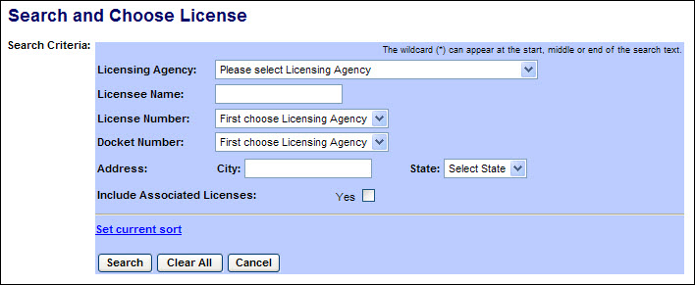
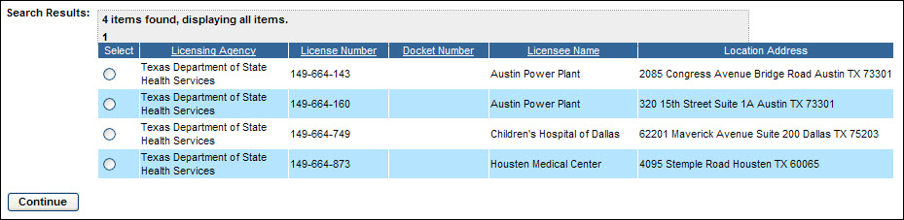
Scenario 3.12
Record Irretrievable Sources
To Record Irretrievable Sources:
From the NSTS Main Menu, under Source Management, click the Record Irretrievable Source link. The Search and Choose License window will be displayed.
Enter the search criteria to display a list of Licenses, and then click Search. A list of licenses meeting the search criteria will be displayed. (If no criteria are entered, all licenses accessible to the user will be listed.)

Slide 60
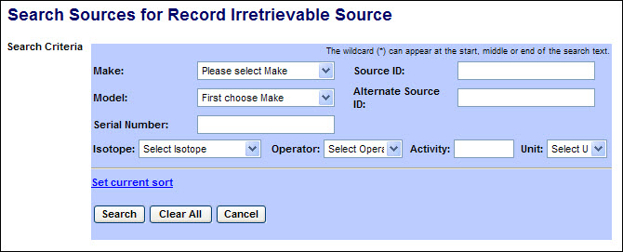
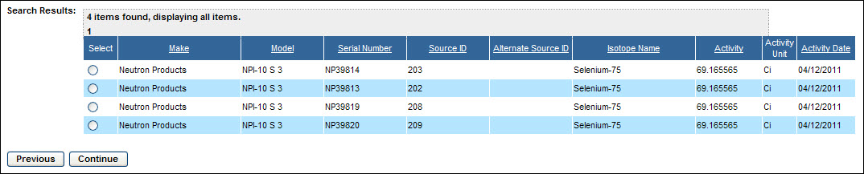
Scenario 3.12
Record Irretrievable Sources
Record Irretrievable Sources Cont.:
Click the radio button for the applicable Licensee, then click the Continue button.
The Search Sources for Record Irretrievable Source window appears:
Enter the search criteria, and then click Search. A list of sources in the selected licensee’s inventory which meet the search criteria will be displayed. (If no criteria are entered, all sources in the licensee’s inventory will be listed.)

Slide 61
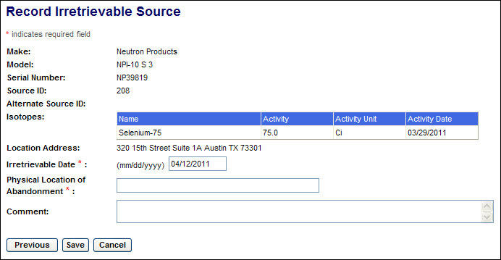
Scenario 3.12
Record Irretrievable Sources
Record Irretrievable Sources Cont.:
Click the radio button ( ) for the irretrievable source, then click the Continue button. The Record Irretrievable Source window will be displayed.
Enter the applicable information in the following fields:
Field Name | Req. Value | Description/Comments | Acceptable Values | Example Value
Irretrievable Date | Y | Enter date source became irretrievable.. | mm/dd/yyyy | 02/09/2011
Physical Location of Abandonment | Y | Enter a description of the location of the irretrievable source. | Free-form text
Comment | N | Enter comments regarding abandonment of the source. | Free-form text

Slide 62
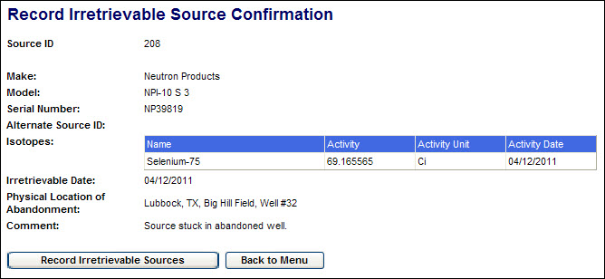
Scenario 3.12
Record Irretrievable Sources
Record Irretrievable Sources Cont.:
Select the Save button. A confirmation of the report will be displayed.
On the confirmation screen, click the Back to Menu button to return to the NSTS Main Menu or click the Record Irretrievable Sources button to record another irretrievable source.

Slide 63
Scenario 3.13
Review Source History
The NRC Staff, Agreement State Staff and DOE Staff need the ability to view a full history of an individual Source’s transfers and Source Status changes. The Review Source History functionality enables the user to see a full life-cycle view of a Source from cradle-to-grave.
Scenario 3.13
A source has been found . How can I find out which licensee last possessed the source?
Under Source Management, click on the Review Source History link
Enter search criteria
Select the appropriate source from the results
Click the Review History button

Slide 64
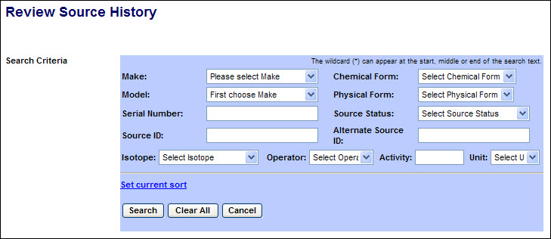
Scenario 3.13
Review Source History
To Review Source History :
From the NSTS Main Menu, under Source Management, click on the Review Source History link. The Review Source History search criteria window appears:
After entering the search criteria, select the Search button. (If no criteria are selected, all sources which the user is authorized to view will be displayed.) The search results display at the bottom of the window:
Scroll to the right to display additional source information.

Slide 65
Scenario 3.13
Review Source History
Review Source History Cont.:
From the NSTS Main Menu, under Source Management, click on the Review Source History link. The Review Source History search criteria window appears:
After entering the search criteria, select the Search button. (If no criteria are selected, all sources which the user is authorized to view will be displayed.) The search results display at the bottom of the window:

Slide 66
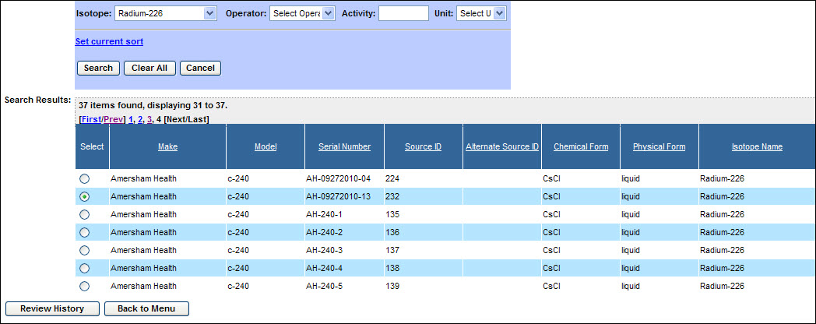
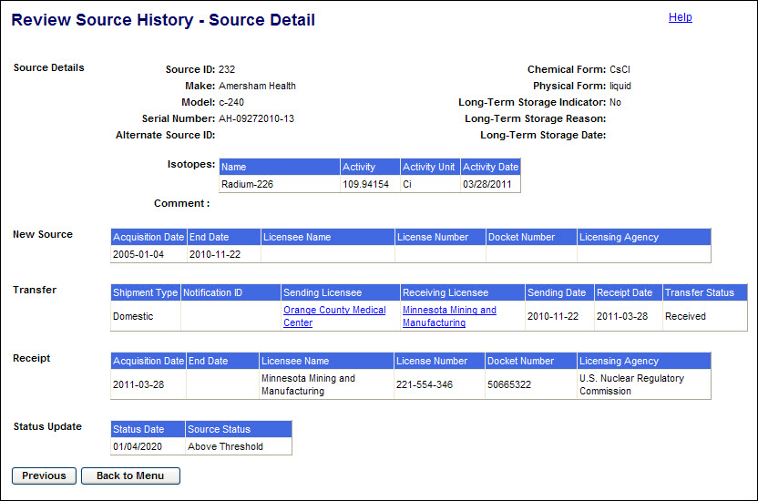
Scenario 3.13
Review Source History
Review Source History Cont.:
Scroll to the right to display additional source information.
Click the radio button ( ) to select a source, and then click the Review History button.

Slide 67
Scenario 3.13
Review Source History
Review Source History Cont.:
After reviewing the information provided, click the Back to Menu button to return to the NSTS Main Menu.
Note: To select a different source, click the Previous button to return to the Review Source History (Search Results) window.

Slide 68
Scenario 3.14
Query Transfers Receipts
The NRC Staff, Agreement State Staff, DOE Staff, and Customs Staff need the ability to view a list of import, export, and domestic transfers of NSTS trackable Sources. The Review Source History functionality enables the user to query such information on specific criteria including shipment vicinity, shipment type, state, foreign country, license agency, license category, and by a range of dates.
Scenario 3.14
I would like to know how many and which licenses exported sources from my agency in the past month
Under Transfer Management, click the Query Transfer/Receipts link
Apply search criteria
Click the Search button

Slide 69
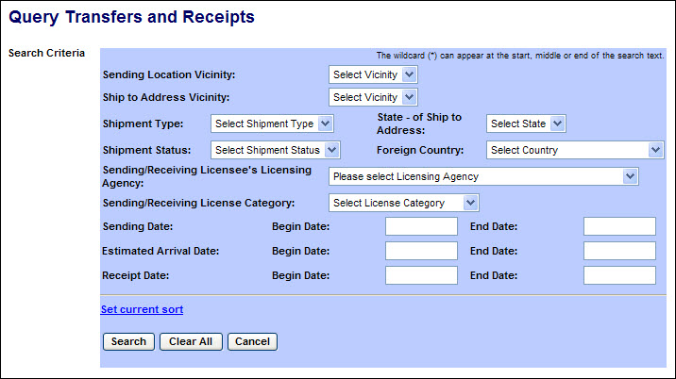
Scenario 3.14
Query Transfers Receipts
To Query Transfers Receipts:
From the NSTS Main Menu, under Transfer Management, click the Query Transfer/Receipts link. The Query Transfers and Receipts search criteria window appears:
After entering the search criteria, select the Search button. (If no criteria are selected, all shipments which the user is authorized to view will be displayed.)

Slide 70
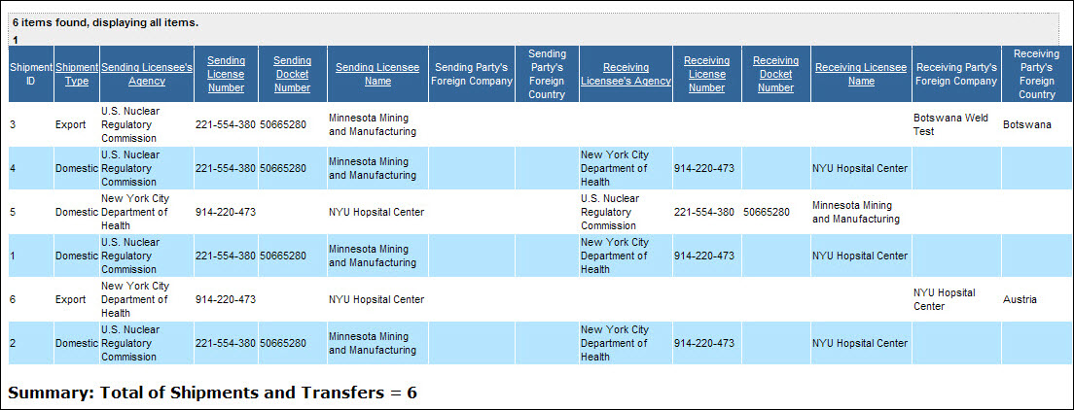
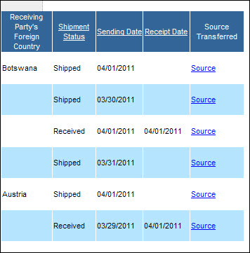
Scenario 3.14
Query Transfers Receipts
Query Transfers Receipts Cont.:
Scroll to the right to display additional source information.
To view the Sources in a shipment, click on the Source link (in the far right column).

Slide 71
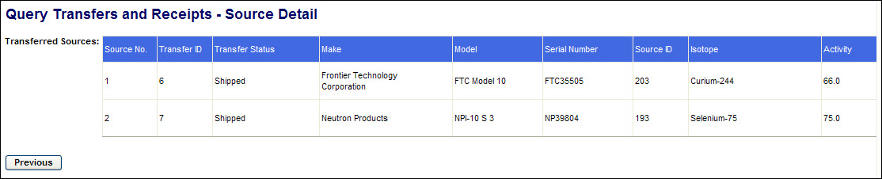
Scenario 3.14
Query Transfers Receipts
Query Transfers Receipts Cont.:
The Query Transfers and Receipts – Source Detail window will appear..
After reviewing the source information, click the Previous button to return to the Search Results screen.
After reviewing the Search Results, click the Back to Menu button to return to the NSTS Main Menu.

Slide 72
Scenario 3.15
Review Pending Transfers
The NRC Staff, Agreement State Staff, and DOE Staff need the ability to view a list of pending or overdue transfers. The Review Pending Transfers functionality enables the user to view details about overdue/pending transfers, as well as the sources within the shipment. The user is also able to use search criteria to narrow/specify results.
Scenario 3.15
I would like to know how many and which licenses in my agency currently have overdue transfers
Under Transfer Management, click the Review Pending Transfers link.
Apply search criteria
Review results

Slide 73
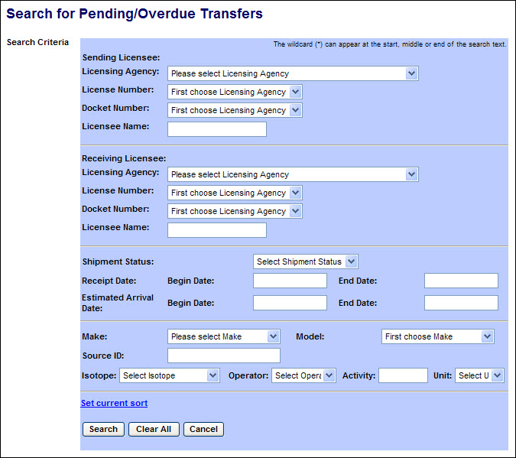
Scenario 3.15
Review Pending Transfers
To Review Pending Transfers :
From the NSTS Main Menu, under Transfer Management, click the Review Pending Transfers link. The Review Pending/Overdue Transfers search criteria window appears:

Slide 74



Scenario 3.15
Review Pending Transfers
Review Pending Transfers Cont.:
After entering the search criteria, select the Search button. (If no criteria are selected, all shipments which the user is authorized to view will be displayed.)
Scroll to the right to display additional source information.
To view the Sources in a shipment, click the Source Details link.
The Review Pending/Overdue Transfers – Source Detail window will appear.

Slide 75
Scenario 3.15
Review Pending Transfers
Review Pending Transfers Cont.:
After reviewing the source information, click the Previous button to return to the Search Results screen.
If an alert has been generated for a shipment, the details may be viewed by clicking on Alert Details (in the far right column). After reviewing the alert details, click the Previous button to return to the Search Results screen.
After reviewing the Search Results, click the Back to Menu button to return to the NSTS Main Menu.

Slide 76
Scenario 3.16
Record Import Notifications
According to the IAEA Code of Conduct, exporting companies shall notify the importing countries for Category 1 or Category 2 Sources. The NRC receives and records Import Notifications. The Record Import Notifications functionality enables the user to record this information in the NSTS.
Scenario 3.16
How can I update NSTS with an Import Notification?
Under Transfer Management, click the Record Import Notifications link.
Enter the import , recipient, end -use location, date, aggregated isotope, and source information
Save

Slide 77
Scenario 3.16
Record Import Notifications
To Record Import Notifications:
From the NSTS Main Menu, under Transfer Management, click the Record Import Notifications link. The Record Import Notifications input form will be displayed.
Enter the information from the import notification received from the exporting company. Required fields are marked with a red asterisk.

Slide 78

Scenario 3.16
Record Import Notifications
Record Import Notifications Cont.:

Slide 79


Scenario 3.16
Record Import Notifications
Record Import Notifications Cont.:
If the end-use locations are included in the notification, enter the number of locations to be described and click the Enter End-Use Location link.
The Location Address form will be displayed.
After entering the address information, click Continue to save the addresses and return to the Import Notification screen. To clear the form and remain on the End-Use Location screen, click Reset. To return to the Import Notification screen without saving address information, click Cancel.

Slide 80


Scenario 3.16
Record Import Notifications
Record Import Notifications Cont.:
After entries have been made in all of the required fields (marked with a red asterisk), enter the number of Aggregated Isotopes in the notification and click Continue.
The Aggregated Isotopes form will be displayed.
Select the isotope(s) in the sources to be imported, and for each isotope enter the total activity of all sources. Then select the number of sources to be imported and click Continue. The source description form will be displayed.
Note: Entry of aggregated activity is not required. If aggregated activity is not entered, then following entry of the source information, the system will calculate the aggregated activity of each isotope.

Slide 81


Scenario 3.16
Record Import Notifications
Record Import Notifications Cont.:
For each source, select the Make and Model, and enter the Serial Number. The isotope in the selected Make/Model will be displayed. .

Slide 82

Scenario 3.16
Record Import Notifications
Record Import Notifications Cont.:
Enter the Activity (TBq) and Activity Date. Click Continue to save the entries and return to the Import Notification screen.
Note: If the source Make or Model is not found in the dropdown list, click the Enter Unrecorded Make/Model button and record the sources as described in the notification received from the exporting company. (See Section 4.4.5 of the NSTS User Guide.) After recording the Make and Model, complete the entry of source data for the Import Notification
Click the Save button to create the notification. The Record Import Notification Confirmation will be displayed. When saved, a unique Notification ID is assigned to each notification by the system.

Slide 83

Scenario 3.16
Record Import Notifications
Record Import Notifications Cont.:
On the confirmation screen, click the Back to Menu button to return to the NSTS Main Menu, or click the Record Import Notification button to record another Import Notification.

Slide 84
Scenario 3.17
Update Import Notifications
According to the IAEA Code of Conduct, exporting companies shall notify the importing countries for Category 1 or Category 2 Sources. The NRC receives and records Import Notifications. The Update Import Notifications functionality enables the user to update Import Notifications previously entered into NSTS.
Scenario 3.17
How can I update a previously entered Import Notification?
Under Transfer Management, click the Update Import Notifications link
Enter search criteria
Select the desired Import Notification from the results
Update the Notification as appropriate
Save

Slide 85

Scenario 3.17
Update Import Notifications
To Update Import Notifications:
From the NSTS Main Menu, under Transfer Management, click the Update Import Notifications link. The Update Import Notifications search criteria window will be displayed.

Slide 86

Scenario 3.17
Update Import Notifications
Update Import Notifications Cont.:
After entering the search criteria, select the Search button. (If no criteria are selected, all import notifications which the user is authorized to view will be displayed.)
Scroll to the right to display additional notification information.
Select a notification to update or delete by clicking the radio button in the Select column and then the Continue button. The Update Import Notification screen will be displayed.

Slide 87

Scenario 3.17
Update Import Notifications
Update Import Notifications Cont.:
Update the details of the Import Notification and click the Save button. The revised notification will be displayed in an Update Import Notification confirmation screen.

Slide 88
Scenario 3.17
Update Import Notifications
Update Import Notifications Cont.:
The Reset button will return the notification fields to their saved values and leave the Update Import Notification edit screen displayed.
Note: Only fields editable on this screen will be reset. Changes to the notification made using the Change or Remove links in the form; and the addition of End-Use Locations, Aggregated Isotopes, and Sources will not be undone by the Reset button. Instead, use the Cancel button to prevent such changes from being saved.
The Cancel button will return the user to the Main Menu without saving any changes to the Import Notification.
To delete the Import Notification from NSTS, click the Delete Notification button.
On the Update Import Notification confirmation screen, click the Update Import Notification button to search for and update another Import Notification.
Click the Back to Menu button to return to the NSTS Main Menu

Slide 89
Scenario 3.18
Record Export Notifications
According to the IAEA Code of Conduct, exporting companies shall notify their own regulatory authority and that of the importing country prior to shipment of Category 1 and Category 2 Sources. The NRC receives and records Export Notifications of sources sent by U.S. licensees to foreign companies. The Record Export Notifications functionality enables the user to record this information in the NSTS.
Scenario 3.18
How can I update NSTS with an Export Notification
Under Transfer Management, click the Record Export Notifications link
Enter the Export, foreign recipient, end -use location, date, aggregated isotope, and source information
Save

Slide 90

Scenario 3.18
Record Export Notifications
To Record Export Notifications:
From the NSTS Main Menu, under Transfer Management, click the Record Export Notifications link. The Record Export Notification window will be displayed.

Slide 91


Scenario 3.18
Record Export Notifications
Record Export Notifications Cont.:
If the end-use locations are included in the notification, enter the number of locations to be described and click the Enter End-Use Location link.
The Location Address form will be displayed.

Slide 92

Scenario 3.18
Record Export Notifications
Record Export Notifications Cont.:
After entering the address information, click Continue to save the addresses and return to the Import Notification screen. To clear the form and remain on the End-Use Location screen, click Reset. To return to the Export Notification screen without saving address information, click Cancel.
Note: The End-Use Location addresses entered will not be displayed on the Record Export Notification screen until after the exported source information has been entered.
After entries have been made in all of the required fields (marked with a red asterisk), enter the number of Aggregated Isotopes in the notification and click Continue.
The Aggregated Isotopes form will be displayed.

Slide 93

Scenario 3.18
Record Export Notifications
Record Export Notifications Cont.:
Select the isotope(s) in the sources to be exported, and for each isotope enter the total activity of all sources. Then select the number of sources to be exported and click Continue. The source description form will be displayed.
Note: Entry of aggregated activity is not required. If aggregated activity is not entered, then following entry of the source information, the system will calculate the aggregated activity of each isotope.

Slide 94

Scenario 3.18
Record Export Notifications
Record Export Notifications Cont.:
For each source, select the Make and Model, and enter the Serial Number. The isotope in the selected Make/Model will be displayed.

Slide 95

Scenario 3.18
Record Export Notifications
Record Export Notifications Cont.:
Enter the Activity (TBq) and Activity Date. Click Save to save the entries and return to the Import Notification screen.
Note: If the source Make or Model is not found in the dropdown list, click the Enter Unrecorded Make/Model button and record the sources as described in the notification received from the exporting company. (See Section 4.4.5 of the NSTS User Guide.) After recording the Make and Model, complete the entry of source data for the Export Notification

Slide 96

Scenario 3.18
Record Export Notifications
Record Export Notifications Cont.:
Click the Save button to complete creation of the notification. The Record Export Notification Confirmation will be displayed. When saved, a unique Notification ID is assigned to each notification by the system.

Slide 97

Scenario 3.18
Record Export Notifications
Record Export Notifications Cont.:
On the confirmation screen, click the Back to Menu button to return to the NSTS Main Menu, or click the Record Export Notification button to record another Export Notification.

Slide 98
Scenario 3.19
Update Export Notifications
According to the IAEA Code of Conduct, exporting companies shall notify the importing countries for Category 1 or Category 2 Sources. The NRC receives and records Import Notifications. The Update Import Notifications functionality enables the user to update Import Notifications previously entered into NSTS.
Scenario 3.19
How can I update a previously entered Export Notification?
Under Transfer Management, click the Update Export Notifications link.
Enter search criteria
Select the desired Export Notification from the results
Update the Notification as appropriate
Save

Slide 99

Scenario 3.19
Update Export Notifications
To Update Export Notifications:
From the NSTS Main Menu, under Transfer Management, click the Update Export Notifications link. The Update Export Notifications search criteria window will be displayed.

Slide 100

Scenario 3.19
Update Export Notifications
Update Export Notifications Cont.:
After entering the search criteria, select the Search button. (If no criteria are selected, all export notifications which the user is authorized to view will be displayed.)
Scroll to the right to display additional notification information.
Select a notification to update or delete by clicking the radio button in the Select column and then the Continue button.
The Update Export Notification screen will be displayed.

Slide 101

Scenario 3.19
Update Export Notifications
Update Export Notifications Cont.:
Update the details of the Export Notification and click the Save button. The revised notification will be displayed in an Update Export Notification Confirmation screen.

Slide 102
Scenario 3.19
Update Export Notifications
Update Export Notifications Cont.:
The Reset button will return the notification fields to their saved values and leave the Update Export Notification edit screen displayed.
Note: Only fields editable on this screen will be reset. Changes to the notification made using the Remove links in the form; and the addition of End-Use Locations, Aggregated Isotopes, and Sources will not be undone by the Reset button. Instead, use the Cancel button to prevent such changes from being saved.
The Cancel button will return the user to the Main Menu without saving any changes to the Export Notification.
To delete the Export Notification from NSTS, click the Delete Notification button.
On the Update Export Notification confirmation screen, click the Update Export Notification button to search for and update another Export Notification.
Click the Back to Menu button to return to the NSTS Main Menu.

Slide 103
Scenario 3.20
Review Import Notifications
The Agencies need the capability to view the Import Notifications for various reasons (e.g., national security, trend analysis, and reports to congress). The Review Import Notifications functionality enables the user to retrieve and review the notifications
Scenario 3.20
How can I see a list of all import notifications entered during a specific period?
Under Transfer Management, click the Review Import Notifications link
Apply search criteria
To view Notification details select the radio button and click Continue

Slide 104

Scenario 3.20
Review Import Notifications
To Review Import Notifications:
From the NSTS Main Menu, under Transfer Management, click the Review Import Notifications link. The Review Import Notifications search criteria window appears:
After entering the search criteria, select the Search button. (If no criteria are selected, all shipments which the user is authorized to view will be displayed.)

Slide 105

Scenario 3.20
Review Import Notifications
Review Import Notifications Cont.:
Scroll to the right to display additional source information.
To view the details of a notification, select the radio button in the Select column and click on Continue.

Slide 106

Scenario 3.20
Review Import Notifications
Review Import Notifications Cont.:
The Review Import Notification Detail window will appear.
After reviewing the notification information, click the Previous button to return to the Search Results screen.
After reviewing the Search Results, click the Back to Menu button to return to the NSTS Main Menu.

Slide 107
Scenario 3.21
Review Export Notifications
The Agencies need the capability to view the Export Notifications for various reasons (e.g., national security, trend analysis, and reports to congress). The Review Export Notifications functionality enables the user to retrieve and review the notifications
Scenario 3.21
How can I see a list of all export notifications entered during a specific period?
Under Transfer Management, click the Review Export Notifications link
Apply search criteria
To view Notification details select the radio button and click Continue

Slide 108

Scenario 3.21
Review Export Notifications
To Review Export Notifications:
From the NSTS Main Menu, under Transfer Management, click the Review Export Notifications link.
The Review Export Notifications search criteria window appears:
After entering the search criteria, select the Search button. (If no criteria are selected, all shipments which the user is authorized to view will be displayed.)

Slide 109


Scenario 3.21
Review Export Notifications
Review Export Notifications Cont.:
To view the details of a notification, select the radio button in the Select column and click on Continue.
The Review Export Notification Detail window will appear.

Slide 110
Scenario 3.21
Review Export Notifications
Review Export Notifications Cont.:
After reviewing the notification information, click the Previous button to return to the Search Results screen.
After reviewing the Search Results, click the Back to Menu button to return to the NSTS Main Menu.

Slide 111
Scenario 3.22
Manage Reports
The Manage Reports functionality enables the user to generate, view, and download reports of NSTS data.
Scenario 3.22
How can I view and download a report from NSTS?
Under Report Management, click the Manage Reports link.
Search and Choose an existing report template
View/Download report as appropriate

Slide 112

Scenario 3.22
Manage Reports
To Manage Reports:
From the NSTS Main Menu, under Report Management, click the Manage Reports link. The Report Search criteria screen will be displayed.
To search for reports with a specific word or text string in the title, enter an asterisk (*), then the word or text string, followed by an asterisk (*). For example, *isotope*
After entering the search criteria, click the Search button. (If no criteria are selected, all reports which the user is authorized to run will be displayed.) The search results will be displayed below the search criteria form.

Slide 113

Scenario 3.22
Manage Reports
Manage Reports Cont.:
From the search results, select the radio button ( ) for the desired report. Then click one of the action buttons below the list:
View Report will display the report results on-screen.
Download Report will download the report results in one of several file formats.
Schedule Report will enable the user to set a date & time for the report to run, either once or repeatedly at a set interval, e.g., daily, weekly, etc.
Report History will display a list of previously run scheduled-reports (Report Instances) and the scheduled run date of the next report instance. An existing report instance can be selected from the history list and viewed or downloaded.
Report Properties will display and allow modification of the properties of the report. This option is available only to NSTS Analysts.

Slide 114

Scenario 3.22
Manage Reports
Manage Reports Cont.:
From the search results, select the radio button ( ) for the desired report. Then click one of the action buttons below the list:
View Report will display the report results on-screen.
Download Report will download the report results in one of several file formats.
Schedule Report will enable the user to set a date & time for the report to run, either once or repeatedly at a set interval, e.g., daily, weekly, etc.
Report History will display a list of previously run scheduled-reports (Report Instances) and the scheduled run date of the next report instance. An existing report instance can be selected from the history list and viewed or downloaded.
Report Properties will display and allow modification of the properties of the report. This option is available only to NSTS Analysts.
Selecting View Report will display the Parameters for View Report screen. The parameter selection options available will vary depending on the selected report.

Slide 115

Scenario 3.22
Manage Reports
Manage Reports Cont.:
Select the parameters for the report. (In most drop-down lists, multiple selections can be made by depressing the Ctrl key when selecting each additional item.)
After selecting the desired parameters of the report, click the Run Report button. The report results will be displayed on a new screen.
Use the tools at the top of the report to print the report, go to other pages of the report, and search for text within the report.
Click the Previous button to return to the report parameters selection screen. Click Cancel to go to the Main Menu.

Slide 116


Scenario 3.22
Manage Reports
Manage Reports Cont.:
From the Report Search results list (Figure xx), click Download Report to download the report results in one of several file formats. The Parameters for Report screen will be displayed.
Select the parameters for the report. (In most drop-down lists, multiple selections can be made by depressing the Ctrl key when selecting each additional item.)
After selecting the desired parameters of the report, click the Next button. The File Format for Report screen will be displayed.

Slide 117

Scenario 3.22
Manage Reports
Manage Reports Cont.:
Reports can be downloaded in several file formats, including PDF, MS Excel, MS Word, .RTF, .TXT, .CSV, and .XML.
Select the desired file format for the download and click the Submit button. The report will be displayed either in the application associated with the file type or in an Internet Explorer screen.
If the report results are displayed in an Internet Explorer window, it will be necessary to click the browser back button to return to NSTS. Do not close the browser window or your session will be closed without having logged off and you will need to wait at least 10 minutes for your session to timeout before logging on again.
Use the application’s or Internet Explorer’s tools to save, print, and navigate in the report results.

Slide 118

Scenario 3.22
Manage Reports
Manage Reports Cont.:
From the Report Search results list (Figure xx), click Schedule Report to set a date & time for the report to run, either once or repeatedly at a set interval, e.g., daily, weekly, etc. The Parameters for Run/Schedule Report screen will be displayed.
Select the parameters for the report. (In most drop-down lists, multiple selections can be made by depressing the Ctrl key when selecting each additional item.)
After selecting the desired parameters of the report, click the Next button. The Report Instance Values screen will be displayed.

Slide 119

Scenario 3.22
Manage Reports
Manage Reports Cont.:
Use this screen to select additional NSTS users to be sent an email notification of availability of a new report instance and instructions for retrieving it after the report has been run. The list of possible recipients comprises those users with permission to view the data in the report results.
After entry of the Report Instance Values is complete, click the Next button. The Report Schedule Settings screen will be displayed.

Slide 120


Scenario 3.22
Manage Reports
Manage Reports Cont.:
Reports can be scheduled to run either once at a specified date and time (including ‘Now’) or periodically on a schedule set by the requestor. Several frequency intervals are available.
Select the desired frequency and click the Submit button. On the Report Schedule Settings screen, the date and time options associated with the selected frequency will be displayed.

Slide 121

Scenario 3.22
Manage Reports
Manage Reports Cont.:
Using the required format, enter the date and time at which the report should first be run, and enter an end date for a series of reports.
After entry of the report schedule settings are complete, click the Next button. The Run/Schedule Report Confirmation screen will be displayed.

Slide 122

Scenario 3.22
Manage Reports
Manage Reports Cont.:
To view, download, or schedule another report, click on the Manage Report button to return to the Report Search screen. Click on Back to Menu to go to the main menu.
Each time a scheduled report is run, including ‘Now,” an email notification of availability of a new report instance and instructions for retrieving it will be sent to the report recipients.
In NSTS, follow the notification instructions to search for the specified report.

Slide 123


Scenario 3.22
Manage Reports
Manage Reports Cont.:
Select the report in the search results list and click the Report History button. The list of report instances will be displayed

Slide 124

Scenario 3.22
Manage Reports
Manage Reports Cont.:
Report instances that are available to view will have a Status of “Success.” To see the report parameters and execution date/time & frequency information, click the Success link. The Instance Status screen will be displayed
To return to the list of report instances, click the Close button.
The next instance of a report to be run will have a Status of “Recurring.” To see the report parameters and execution date/time & frequency information, click the Recurring link. The Instance Status screen will be displayed.

Slide 125

Scenario 3.22
Manage Reports
Manage Reports Cont.:
To return to the list of report instances, click the Close button.

Slide 126

Scenario 3.22
Manage Reports
Manage Reports Cont.:
The buttons on the Report Instances screen have the following functions:
For an instance with the status of Success, the View/Reschedule button (or the Report Run Date link) will display the report results.
For an instance with the status of Recurring, the View/Reschedule button (or the Report Run Date link) will restart the sequence of report scheduling screens for entry of report parameters, notification recipients, and schedule settings. (See #s 8-12)
The Pause/Resume button will suspend the running of a report in Recurring status and will reset a Paused report to Recurring.
For an instance with a status of Success, the Download button will allow downloading of the report results. The File Format for Report screen will be displayed. (See #6)
For an instance with the status of Recurring, the Download button will return an NSTS Unrecoverable Error because no report results are yet available for the selected instance.
From the Report Search results list (Figure xx), click Report Properties to review and update the properties of a report. (Available only to NSTS Analysts.) The Report Properties screen will be displayed.

Slide 127

Scenario 3.22
Manage Reports
Manage Reports Cont.:
A report can be enable or disabled, and can be made available to agency staff users or only to NSTS analysts. If made available to agency staff users, it can be available to all agencies or to only one or a selected set of agencies.
After reviewing or updating the report settings, click Submit, and the Update Report Properties Confirmation screen will be displayed.

Slide 128

Scenario 3.22
Manage Reports
Manage Reports Cont.:
To view, download, or schedule another report click on the Manage Report button to return to the Report Search screen. Click on Back to Menu to go to the main menu.

Slide 129
Scenario 3.23
Maintain Reports Schedules
The Maintain Reports Schedules functionality is used to view and download the report results of successful report instances, and update the parameters of scheduled report instances.
Scenario 3.23
How can I download an instance of a report previously run?
Under Report Management, click the Maintain Report Schedules link.
Search for and choose the instance of the report to download
Click the download button
Choose Format
Submit

Slide 130


Scenario 3.23
Maintain Reports Schedules
To Maintain Reports Schedules:
From the NSTS Main Menu, under Report Management, click the Maintain Report Schedules link. The Report Instance Search criteria screen will be displayed.
After entering the search criteria, click the Search button. (If no criteria are selected, all instances which the user is authorized to view will be displayed.) The search results will be displayed below the search criteria form.

Slide 131
Scenario 3.23
Maintain Reports Schedules
Maintain Reports Schedules Cont.:
Report instances that are available to view will have a Status of “Success.” To see the report parameters and execution date/time & frequency information, click the Success link. The Instance Status screen will be displayed.
To return to the list of report instances, click the Close button.
The next instance of a report to be run will have a Status of “Recurring.” To see the report parameters and execution date/time & frequency information, click the Recurring link. The Instance Status screen will be displayed.

Slide 132
Scenario 3.23
Maintain Reports Schedules
Maintain Reports Schedules Cont.:
To return to the list of report instances, click the Close button.

Slide 133
Scenario 3.23
Maintain Reports Schedules
Maintain Reports Schedules Cont.:
From the Report Instance Search results list, the report results of a successful instance can be viewed or downloaded, the parameters and schedule of a recurring instance can be reviewed and modified, and the execution of a recurring instance can be paused.
First select the radio button ( ) for the desired instance. Then click one of the action buttons below the list:
For an instance with the status of Success, the View/Reschedule button (or the Report Run Date link) will display the report results. (See #6 below)
For an instance with the status of Recurring, the View/Reschedule button (or the Report Run Date link) will restart the sequence of report scheduling screens for entry of report parameters, notification recipients, and schedule settings. (See #7 below)
The Pause/Resume button will suspend the running of a report in Recurring status and will reset a Paused report to Recurring.
For an instance with a status of Success, the Download button will allow downloading of the report results. The File Format for Report screen will be displayed. (See #12 below)
For an instance with the status of Recurring, the Download button will return an NSTS Unrecoverable Error because no report results are yet available for the selected instance. (See #14 below)

Slide 134

Scenario 3.23
Maintain Reports Schedules
Maintain Reports Schedules Cont.:
To view the results of an instance with the Status of Success, click the View/Reschedule button (or the Report Run Date link). The report results will be displayed on a new screen.

Slide 135
Scenario 3.23
Maintain Reports Schedules
Maintain Reports Schedules Cont.:
Use the tools at the top of the report to print the report, go to other pages of the report, and search for text within the report.
Click the Close button to return to the list of report instances.
To review and modify the parameters of an instance with the Status of Recurring, click the View/Reschedule button (or the Report Run Date link). The Parameters for Run/Schedule Report screen will be displayed.
Select the parameters for the report. (In most drop-down lists, multiple selections can be made by depressing the Ctrl key when selecting each additional item.)
After selecting the desired parameters of the report, click the Next button. The Report Instance Values screen will be displayed.

Slide 136
Scenario 3.23
Maintain Reports Schedules
Maintain Reports Schedules Cont.:
Use this screen to select additional NSTS users to be sent an email notification of availability of a new report instance and instructions for retrieving it after the report has been run. The list of possible recipients comprises those users with permission to view the data in the report results.
After entry of the Report Instance Values is complete, click the Next button. The Report Schedule Settings screen will be displayed.

Slide 137
Scenario 3.23
Maintain Reports Schedules
Maintain Reports Schedules Cont.:
Reports can be scheduled to run either once at a specified date and time (including ‘Now’) or periodically on a schedule set by the requestor. Several frequency intervals are available.
Select the desired frequency and click the Submit button. On the Report Schedule Settings screen, the date and time options associated with the selected frequency will be displayed.

Slide 138
Scenario 3.23
Maintain Reports Schedules
Maintain Reports Schedules Cont.:
Using the required format, enter the date and time at which the report should first be run, and enter an end date for a series of reports.
After entry of the report schedule settings are complete, click the Next button. The Run/Schedule Report Confirmation screen will be displayed.

Slide 139
Scenario 3.23
Maintain Reports Schedules
Maintain Reports Schedules Cont.:
To view, download, or schedule another report click on the Manage Report button to return to the Report Search screen. Click on Back to Menu to go to the main menu.
From the Report Instance Search results list (Figure xx), to download the report results of an instance with the Status of Success, select the instance and click the Download Report button. The File Format for Report screen will be displayed.
Reports can be downloaded in several file formats, including PDF, MS Excel, MS Word, .RTF, .TXT, .CSV, and .XML.
Select the desired file format for the download and click the Submit button. The report will be displayed either in the application associated with the file type or in an Internet Explorer screen.

Slide 140
Scenario 3.23
Maintain Reports Schedules
Maintain Reports Schedules Cont.:
If the report results are displayed in an Internet Explorer window, it will be necessary to click the browser back button to return to NSTS. Do not close the browser window or your session will be closed without having logged off and you will need to wait at least 10 minutes for your session to timeout before logging on again.
Use the application’s or Internet Explorer’s tools to save, print, and navigate in the report results.
From the Report Instance Search results list (Figure xx), clicking the Download button for an instance with the status of Recurring will return an NSTS Unrecoverable Error because no report results are yet available for the selected instance.

Slide 141
Scenario 3.23
Maintain Reports Schedules
Maintain Reports Schedules Cont.:
Click the Back to update entries button to return to the list of report instances.

Slide 142
Scenario 3.24
Update Alert Status
Many of the alerts generated by business events require investigation and resolution. The NRC Staff, Agreement State Staff, DOE Staff, and NSTS Analyst need the capability to monitor and update the status of the alerts. The Update Alert Status functionality enables the user to view and update alerts generated by NSTS.
Scenario 3.24
Under Alert Management, click the Update Alert Status link
Apply search criteria
View additional Alert details by clicking on the corresponding links for Recipient, Licensee, Source, and Comment links
Select the Alert to be updated
As appropriate change Primary Recipient, Update Status, and Comment
Save
How do I update the status of an alert?

Slide 143

Scenario 3.24
Update Alert Status
To Update Alert Status:
From the NSTS Main Menu, under Alert Management, click the Update Alert Status link. The Search Alerts for Update search criteria window will be displayed.
Enter the search criteria, then click the Search button. The Search Results will display.

Slide 144


Scenario 3.24
Update Alert Status
Update Alert Status Cont.:
Scroll to the right to view additional Alert information.
Click the Recipient Details link under either Primary Recipient or Secondary Recipient to display the name and information about the recipients of the Alert.

Slide 145


Scenario 3.24
Update Alert Status
Update Alert Status Cont.:
(Click the Close button to return to the list of Alerts.)
Click the Licensee link to display the license information associated with the Alert
(Click the Close button to return to the list of Alerts.)
Click the Sources link to display the source information associated with the Alert.

Slide 146


Scenario 3.24
Update Alert Status
Update Alert Status Cont.:
(Click the Close button to return to the list of Alerts.)
Click the Comments link to display any comments associated with the Alert.
(Click the Close button to return to the list of Alerts.)

Slide 147

Scenario 3.24
Update Alert Status
Update Alert Status Cont.:
From the list of Alerts, select the radio button ( ) of the Alert to be updated, then select the Continue button. The Update Alert Status window will be displayed.
If no updates will be made, click the Previous button to return to the list of Alerts or click the Cancel button to return to the NSTS Main Menu.
(See 9. below regarding the Save and Reset buttons.)

Slide 148
Scenario 3.24
Update Alert Status
Update Alert Status Cont.:
A user named as the Primary Recipient and whose role includes Alert Manager for the associated license can update the Alert Status or change the Primary Recipient. Both Primary and Secondary Recipients can add Comments. (Agency Staff can add comments to all Alerts to which they have access.)
To change the Primary Recipient, click the Change Primary Recipient link. A list of users associated with the license which is the subject of the Alert will be displayed
To select a new Primary Recipient, click the radio button ( ) for that user. Then click the Continue button. The Update Alert Status window will be displayed.
(Click the Cancel button to return to the Update Alert Status window without making any change.)

Slide 149
Scenario 3.24
Update Alert Status
Update Alert Status Cont.:
If either the Alert Status or primary Recipient have been changed, a Comment is also required.
(Prior to saving, you may click the Reset button to undo any changes to the Alert Status or Comments and remain in the Update Alert Status Window. The Reset button will not undo a change of the Primary Recipient.
Click the Cancel button to return to the list of current Alerts without saving any changes (including a change of the Primary Recipient.))
To save the updated Alert, click the Save button. The Update Alert Status Confirmation window will be displayed.
(If the Primary Recipient is changed, the new recipient will be sent a copy of the Alert.)

Slide 150

Scenario 3.24
Update Alert Status
Update Alert Status Cont.:
Review the confirmation of changes to the Alert Status.
Click the Update Alert Status button to return to the Search Alerts for Update search criteria window. To return to the Main Menu, click the Back to Menu button.

Slide 151
Scenario 3.25
Review Alert History
Many of the alerts generated by business events require investigation and resolution. The NRC Staff, Agreement State Staff, DOE Staff, and NSTS Analyst need the capability to review and monitor the history of the alerts. The Review Alert History functionality enables the user to view and monitor alerts (open and closed) and view the status history.
Scenario 3.25
Under Alert Management, click the Review Alert History link
Apply search criteria
View additional Alert details by clicking on the corresponding links for Recipient, Comment, and source, links
Select the Alert to be reviewed
How do I review the status history of an alert?

Slide 152

Scenario 3.25
Review Alert History
To Review Alert History:
From the NSTS Main Menu, under Alert Management, click the Review Alert History link. The Search Alerts for Reviewing History search criteria window will be displayed.

Slide 153


Scenario 3.25
Review Alert History
Review Alert History Cont.:
Enter the search criteria and click the Search button. The Search Results will display. (If no criteria are entered, all alerts accessible to the user will be listed.)
Scroll to the right to view additional Alert information.
Click the Recipient Details link under either Primary Recipient or Secondary Recipient to display the name and information about the recipients of the Alert.

Slide 154


Scenario 3.25
Review Alert History
Review Alert History Cont.:
(Click the Close button to return to the Search Results window.)
Click the Comments link to display any comments associated with the Alert.
(Click the Close button to return to the Search Results window.)

Slide 155


Scenario 3.25
Review Alert History
Review Alert History Cont.:
Click the Sources link to display the source information associated with the Alert.
(Click the Close button to return to the Search Results window.)
In the search results window, select the radio button ( ) for the Alert to be reviewed, then click the Review Alert History button. The Review Alert Status History window appears:

Slide 156
Scenario 3.25
Review Alert History
Review Alert History Cont.:
After reviewing the Alert Status History, click the Previous button to return to the Search Results window or click the Cancel button to return to the NSTS Main Menu.

Slide 157
Scenario 3.26
Review Long-Term Storage Sources
The NRC Staff, Agreement State Staff, and DOE Staff need the ability to easily ascertain which NSTS trackable Sources are in long-term storage by the Licensees that possess them.
The Review Long-Term Storage functionality enables the user to retrieve a list of NSTS trackable sources which are in long-term storage. Only those sources which the user is authorized to view will be displayed.
Scenario 3.26
How do I determine which sources in my Agency are in Long-Term Storage ?
Source Management, select the Review Long—Term Storage Sources link
Apply search criteria
Review Results

Slide 158

Scenario 3.26
Review Long-Term Storage Sources
To Review Long-Term Storage Sources:
From the NSTS Main Menu, under Source Management, select the Review Long—Term Storage Sources link. The Search Source for Long-Term Storage Sources window appears.
After entering the search criteria, select the Search button. (If no criteria are selected, all sources in long-term storage which the user is authorized to view will be displayed.)

Slide 159

Scenario 3.26
Review Long-Term Storage Sources
Review Long-Term Storage Sources Cont.:
Scroll to the right to display additional source information.
After reviewing the information provided, click the Back to Menu button to return to the NSTS Main Menu.

Slide 160
Scenario 3.27
Maintain Vicinity
The NSTS Administrator needs the ability to create and modify a Vicinity by specifying a list of zip codes. A Vicinity is simply a geographical area delineated by a set of zip codes. The zip codes to be included in a Vicinity must have been entered in the Code Table named Zip. The Code Tables are accessed by clicking the Maintain Code Tables link under Code Table Management on the System Administrator’s Main Menu
Scenario 3.27
How do I add a zip code to an existing vicinity?
From the NSTS Administrator Main Menu, under License Management, click the Maintain Vicinity link
Enter Search criteria to search for an existing vicinity or click the New button to create a new one.
Select the desired vicinity and update as appropriate. Save
Add the required information for a new vicinity. Save

Slide 161

Scenario 3.27
Maintain Vicinity
To Maintain Vicinity Cont:
From the NSTS Administrator Main Menu, under License Management, click the Maintain Vicinity link. The Search and Choose Vicinity search criteria window will be displayed.
This screen has links to create a Vicinity or to search for an existing Vicinity to modify.
To create a Vicinity, click the New button. The Create Vicinity screen will be displayed.

Slide 162


Scenario 3.27
Maintain Vicinity
Maintain Vicinity Cont.:
After entering a Vicinity Name (and a Description and Comment, if desired), enter the number of zip codes to be used to define the Vicinity and click Continue.

Slide 163

Scenario 3.27
Maintain Vicinity
Maintain Vicinity Cont.:
The Add Zip Codes to Vicinity screen will be displayed.
To select a zip code, first select the State and then the City from the dropdown list. Then select a zip code associated with the State and City. (It is not necessary to select a city. If no city is selected, the list of zip codes displayed will include all for the State. To filter the list of zip codes, select a city.)
After selecting the zip codes to add to the Vicinity, click the Continue button. The Create Vicinity Review screen will be displayed. (If no city was selected, the city of a zip code will not be displayed on the review screen; however, the city will be shown on the confirmation screen.)

Slide 164

Scenario 3.27
Maintain Vicinity
Maintain Vicinity Cont.:
If the Vicinity details and zip code list is correct, click the Save button to create the Vicinity. A Vicinity ID will be assigned and the Create Vicinity Confirmation screen will be displayed

Slide 165

Scenario 3.27
Maintain Vicinity
Maintain Vicinity Cont.:
Click the Create Vicinity button to create another Vicinity, or click the Back to Menu button to return to the Main Menu.
To modify an existing Vicinity, on the Search and Choose Vicinity window enter the search criteria and click the Search button. The search results will be displayed below the search form. (If no criteria are entered, all Vicinities will be listed.

Slide 166

Scenario 3.27
Maintain Vicinity
Maintain Vicinity Cont.:
Select the Vicinity to be modified by clicking the radio button ( ) in the Select column and then click the Update button. The Update Vicinity screen will be displayed.

Slide 167

Scenario 3.27
Maintain Vicinity
Maintain Vicinity Cont.:
Make the desired changes, including adding or removing zip codes, and click the Save button. The Update Vicinity Confirmation screen will be displayed

Slide 168
Scenario 3.28
Maintain Licensee Relationship
The NSTS Administrator needs the capability to link multiple Licenses, so that reports, research, and analyses can be performed for a group of associated Licenses.
Scenario 3.28
From the NSTS Administrator Main Menu, under Licensing Agency Management, click the Maintain License Relationship link
Enter Search criteria to search and choose Parent license
Click the Associate License button
Enter Search criteria to search and choose Children licenses.
Click the Add New Child Licenses button
Review Information
Add required comment
Click the Associate License button
How do I associate a group of licenses to one parent license?

Slide 169


Scenario 3.28
Maintain Licensee Relationship
To Maintain Licensee Relationship:
From the NSTS Administrator Main Menu, under Licensing Agency Management, click the Maintain License Relationship link. The Search and Choose License for Maintain Relationship search criteria window will be displayed and used to select the parent license.
To establish a license relationship, enter the search criteria to find the parent license and click the Search button. The search results will be displayed below the search form. (If no criteria are entered, all licenses will be listed.)

Slide 170


Scenario 3.28
Maintain Licensee Relationship
Maintain Licensee Relationship Cont.:
From the search results, select the radio button ( ) for the desired license. Then click the Continue button. The Maintain License Relationship Detail screen will be displayed.
To select a license to associate as a Child to the Parent license, click the Associate License button. The Search and Choose Children License search criteria screen will be displayed.

Slide 171


Scenario 3.28
Maintain Licensee Relationship
Maintain Licensee Relationship Cont.:
Enter the search criteria to find the child license and click the Search button. The search results will be displayed below the search form. (If no criteria are entered, all licenses will be listed.)
From the search results, select the checkbox () for each license to be added to the relationship as a child. Then click the Add New Child Licenses button. The Associate Licenses with Parent License screen will be displayed.

Slide 172


Scenario 3.28
Maintain Licensee Relationship
Maintain Licensee Relationship Cont.:
Review the entries of the parent and child licenses. If correct, add a Comment (required), and click the Associate License button to save the relationship. The xxx confirmation screen will be displayed.
To disassociate a child license from a parent license, select the Maintain License Relationship link on the Main Menu. Use the search form to find the parent license.
Note: The child license number is displayed in the Associated Licenses column of the search results.
From the search results, select the radio button ( ) for the desired license. Then click the Continue button. The Maintain License Relationship Detail screen will be displayed.

Slide 173
Scenario 3.28
Maintain Licensee Relationship
Maintain Licensee Relationship Cont.:
Select the checkbox () for each child license to be disassociated from the parent. Then click the Disassociate Selected Licenses button. The xxx confirmation screen will be displayed.
Note: From this screen, new child licenses can also be added to a relationship. Click the Associate License button to display the Search and Choose Children License search criteria screen.

Slide 174
Scenario 3.29
Maintain Alert Rules
The NSTS Administrator needs the capability to specify rules that determine when and how alerts are generated and delivered.
Scenario 3.29
How do I change the text of an alert message?
From the NSTS Administrator Main Menu, under Alert Management, click the Maintain Alert Rules link.
Search for an exiting rule or create a new one by clicking the Create Alert Rule button
Enter or change required information as appropriate
Save

Slide 175

Scenario 3.29
Maintain Alert Rules
To Maintain Alert Rules:
From the NSTS Administrator Main Menu, under Alert Management, click the Maintain Alert Rules link. The Search and Choose Alert Rule search criteria window will be displayed.
This screen has links to create a new rule or to search for an existing rule to modify.
To create a new rule, click the Create Alert Rule button. The Create Alert Rule screen will be displayed.

Slide 176

Scenario 3.29
Maintain Alert Rules
Maintain Alert Rules Cont.:
After defining the rule, click Save. The Create Alert Rule Confirmation screen will be displayed.

Slide 177

Scenario 3.29
Maintain Alert Rules
Maintain Alert Rules Cont.:
Click the Create Alert Rule button to create another Alert rule, or click the Back to Menu button to return to the Main Menu.
To search for an existing Alert rule, enter the search criteria on the Search and Choose Alert Rule screen and click the Search button. A list of Alerts rules matching the search criteria will be displayed. (If no search criteria are entered, a list of all Alert rules will be returned.)

Slide 178

Scenario 3.29
Maintain Alert Rules
Maintain Alert Rules Cont.:
From the list of Alert rules, select the radio button ( ) of the rule to be updated, and click the Update Alert Rule button. The Update Alert Rule window will be displayed.

Slide 179

Scenario 3.29
Maintain Alert Rules
Maintain Alert Rules Cont.:
After entering the needed changes, click the Save button to update the rule. An Update Alert Rule Confirmation window will be displayed.

Slide 180

Scenario 3.29
Maintain Alert Rules
Maintain Alert Rules Cont.:
To search for another rule to update, click the Update Alert Rule button. Click the Back to Menu button to return to the Main Menu.

Slide 181
Scenario 3.30
Upload Report
Based on a request from the NRC for a specific report, a system developer will create a report template using Crystal Reports and save the file in .RPT format. (The tools, steps, and validation of report design are described in the NSTS Report Designer Guide.)
The file is then uploaded by an NSTS Analyst to the NSTS application server and “published.” Publishing pairs the report template with the report properties set by the analyst so that the report is available to the appropriate user group(s).
Scenario 3.30
How do I upload a new report for use in NSTS?
NSTS Main Menu, under Report Management, click the Upload Report link
Click the Browse button to find and select the file to be uploaded
Define report properties
Click the submit button to publish the report

Slide 182

Scenario 3.30
Upload Report
To Upload Report:
From the NSTS Main Menu, under Report Management, click the Upload Report link. The Publish Report screen will be displayed.
Click the Browse button and select the file to be uploaded.
If the report is to be available for use, click the Enable checkbox ().
Chose the Report Role for which this report will be available by clicking the corresponding radio button ( ).
If Agency Staff is selected, the Agency selection tool will be displayed.

Slide 183

Scenario 3.30
Upload Report
Upload Report Cont.:
Use the tool to add one, several, or all agencies to the list of agencies allowed to run the report.
Select an agency (or multiple agencies by depressing the Ctrl key while selecting the additional agencies), and click the Add button. Click the Add All button to add all agencies to the Allowed Agencies list.
After selecting the file to be uploaded and setting the properties of the report, click the Submit button. The Publish Report Confirmation screen will be displayed.

Slide 184

Scenario 3.30
Upload Report
Upload Report Cont.:
Click the Close button to return to the main menu.

Slide 185
Scenario 3.31
Update Message in NSTS Mailbox
Messages sent to the NSTS Mailbox are recorded and available for update. The Update Message in NSTS Mailbox functionality enables the user to view open messages and update the status as appropriate.
Scenario 3.31
How do I update the status of an open message in the NSTS Mailbox?
Under Alert Management click the Update Message in NSTS Mailbox Link
Select the message to be update
Change the status as appropriate
Save

Slide 186


Scenario 3.31
Update Message in NSTS Mailbox
To Update Message in NSTS Mailbox:
From the NSTS Main Menu, under Alert Management, click the Update Message in NSTS Mailbox link. The View and Choose Open Messages screen is displayed.
Select the open message to be updated by clicking the radio button next to the desired message ( ). Click the continue button.
The Update Message Status screen will be displayed.

Slide 187

Scenario 3.31
Update Message in NSTS Mailbox
Update Message in NSTS Mailbox Cont.:
Update the status and click the save button. The Update Message Status Confirmation screen will display.
Click the Back button to return to the main menu

