Slide 1
Safety Culture
A Continuous Journey
September 25, 2013

Slide 2
Welcome/Warm-up
The webinar will begin shortly, please answer the following questions in the chat window.
What are some of the traits that contribute to a positive Safety Culture?
What effect does a positive Safety Culture have on safety/security of licensed activities?
What kind of outreach have you done in your State?

Slide 3
Safety Culture
A Continuous Journey
September 25, 2013

Slide 4


Today’s Presenters
Cindy Flannery, CHP
Senior Health Physicist
June Cai
Senior Liaison Project Manager

Slide 5
Objectives
Provide a clear and consistent message on the expectations contained in the NRC Safety Culture Policy Statement
Discuss how Agreement States can support the implementation of the policy with their licensees.

Slide 6
Presentation Overview
What is Safety Culture?
Why is Safety Culture Important?
NRC Safety Culture Activities
  Background/Development of NRC’s Policy Statement
  Elements of Safety Culture Policy Statement
  Case Studies

Slide 7
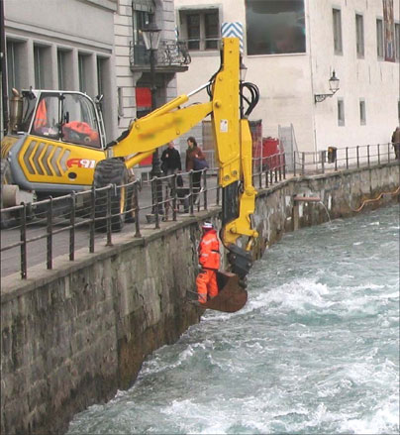
What is Safety Culture?
Not separate or distinct from organizational culture
A goal that sometimes competes with an organization’s primary mission

Slide 8
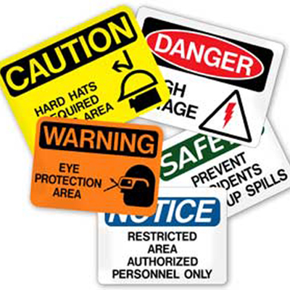

What is Safety Culture?
Safety culture is the extent to which safety is emphasized, both formally and informally, by an organization and its members.

Slide 9

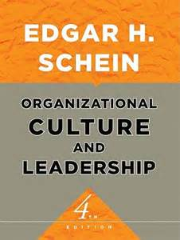
Organizational Culture
“A pattern of shared basic assumptions that was learned by a group as it solved its problems of external adaptation and internal integration, that has worked well enough to be considered valid and, therefore, to be taught to new members as the correct way you perceive, think, and feel in relation to those problems.”
A combination of the intended (the formal organization) and the unintended (the informal organization)
9

Slide 10
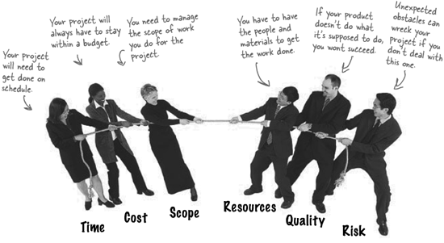
Culture Resolves Goal Conflicts
Every organization must resolve conflicts between sometimes competing goals
10

Slide 11
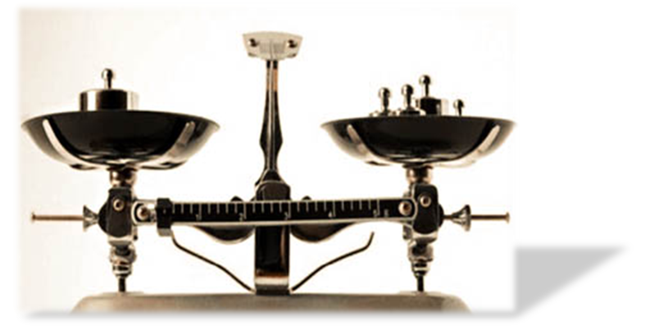
Culture Resolves Goal Conflicts
The organization’s members (groups and individuals) also daily face goal conflicts in performing their jobs
  Make local choices among competing goals
  Take actions that demonstrate goal-conflict resolution
11

Slide 12

Culture Resolves Goal Conflicts
The organization’s culture includes guidance for resolving conflicts between goals
12

Slide 13
Subcultures
Larger organizations
Work-related factors
Sometimes Geography
Powerful
Inconsistent with overall culture
13

Slide 14

Occupational Safety
A workplace free from recognized hazards to safety and health, such as exposure to toxic chemicals or excessive noise.

Slide 15
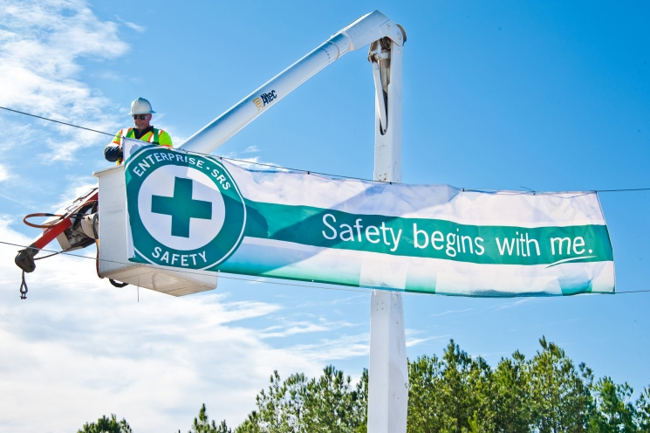
Safety Culture
A positive safety culture is to encourage the development of values and behaviors that support the safe and secure use of nuclear materials.

Slide 16
Why Do We Care?
Safety culture affects safety performance
  injury rates
  accident rates
  patient safety
Results are supported across industries
  aerospace, healthcare, manufacturing, construction, agriculture, off-shore oil and gas, highway safety, aviation

Slide 17

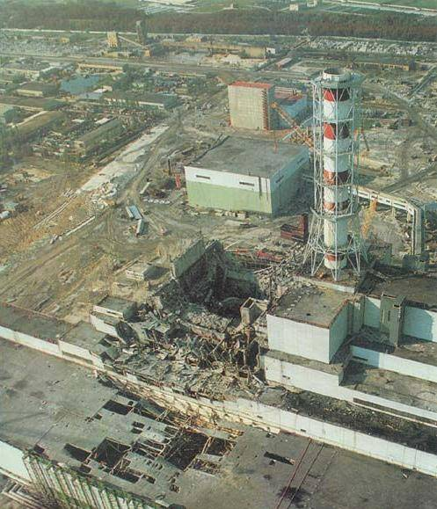
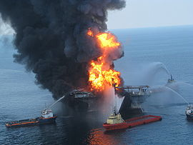
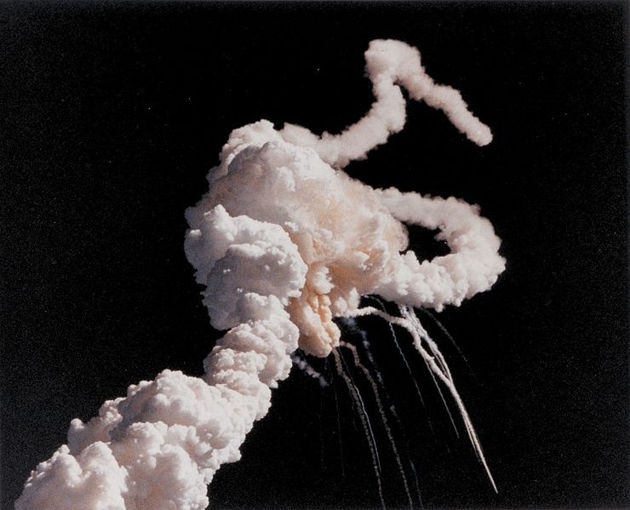
Chernobyl
Challenger
Columbia
Deepwater Horizon

Slide 18
NASA’s Space Shuttle Columbia

Slide 19
NASA’s Space Shuttle Columbia
“Broken safety culture” at NASA
  Ineffective communication
  inadequate concern over deviations from expected performance
  silent safety program
  schedule pressure

Slide 20
Why is Safety Culture Important to the NRC?
Operating experience has demonstrated nexus between safety culture and events
Safety culture contributes to the safe and secure use of radioactive materials
NRC recognizes that licensees bear the primary responsibility for the safe and secure use of nuclear materials, while the NRC, as the regulator, must consider the importance of safety culture in its oversight programs

Slide 21
1989: Conduct of Operations
Policy Statement
  Focuses on nuclear power plants
  Personal dedication and accountability of all individuals engaged in any activity which has a bearing on nuclear power plant safety
  Management fosters the development of a ‘safety culture’ at each facility and promotes a professional working environment in the control room, and throughout the facility, that assures safe operations

Slide 22
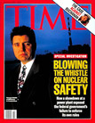
1996: Safety Conscious Work Environment (SCWE)
Policy Statement
Establish and maintain a SCWE
Intended to assure the freedom of employees in the nuclear industry to raise safety concerns without fear of retaliation
Applies to all NRC-regulated activities of licensees, contractors, and applicants

Slide 23
2011: NRC Safety Culture
Policy Statement
Effective June 14, 2011
Includes safety culture definition and nine traits
Applies to all regulated entities
Does not address implementation directly
NRC staff is continuing to engage in activities to increase awareness and understanding of the benefits of a positive safety culture

Slide 24
Statement of Policy
Sets forth the Commission’s expectation that individuals and organizations performing regulated activities establish and maintain a positive safety culture commensurate with the safety and security significance of their actions and the nature and complexity of their organizations and functions

Slide 25
Applicability to Agreement States
  The Commission encourages the Agreement States and other organizations interested in nuclear safety to support the development and maintenance of a positive safety culture, as articulated in the Statement of Policy, within their regulated communities.

Slide 26
SCPS is Not a Matter of Compatibility
The Staff Requirements Memorandum (SRM-SECY-12-0112) from the Commission on the Policy Statement on Agreement State Programs removed references to the Safety Culture Policy Statement.
Policy Statements, to include the Safety Culture Policy Statement, are not a matter of compatibility.

Slide 27
Safety Culture Definition
Nuclear Safety Culture is the core values and behaviors resulting from a collective commitment by leaders and individuals to emphasize safety over competing goals to ensure protection of people and the environment.

Slide 28
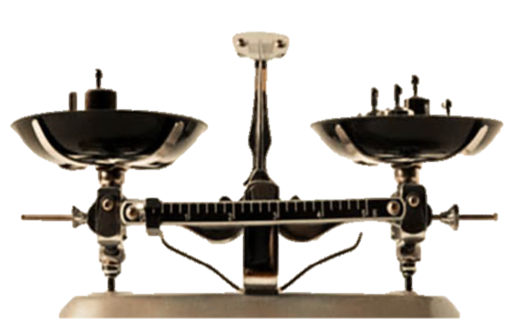
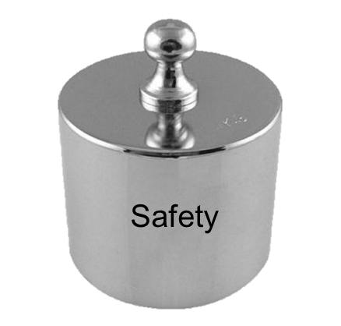
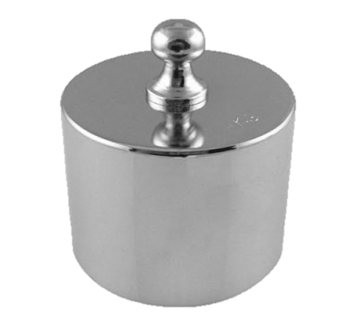


Safety Culture Traits
  Trait: a pattern of
      Thinking
      Feeling
      Behaving
  Emphasizes safety, particularly in goal conflict situations.
production
schedule
cost

Slide 29
Safety Culture Traits
Leadership Safety Values and Actions | Problem Identification and Resolution | Personal Accountability
Leaders demonstrate a commitment to safety in their decisions and behaviors | Issues potentially impacting safety are promptly identified, fully evaluated, and promptly addressed and corrected commensurate with their significance | All individuals take personal responsibility for safety
Work Processes | Continuous Learning | Environment for Raising Concerns
The process of planning and controlling work activities is implemented so that safety is maintained | Opportunities to learn about ways to ensure safety are sought out and implemented | A safety conscious work environment is maintained where personnel feel free to raise safety concerns without fear of retaliation, intimidation, harassment or discrimination
Effective Safety Communications | Respectful Work Environment | Questioning Attitude
Communications maintain a focus on safety | Trust and respect permeate the organization | Individuals avoid complacency and continually challenge existing conditions and activities in order to identify discrepancies that might result in error or inappropriate action

Slide 30
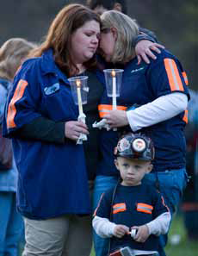
Case Study:
April 2010 Upper Big Branch Mine Explosion
Existing government reports suggest that PCC/Massey “promoted and enforced a workplace culture that valued production over safety including practices calculated to allow it to conduct mining operations in violation of the law.”
“While violations of particular safety standards led to the conditions that caused the explosion, the unlawful policies and practices implemented by employer were the root cause of this tragedy.”

Slide 31
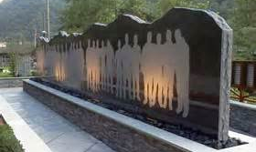
“Lessons Learned” from Upper Big Branch Mine Explosion
  Senior Management dictates the tone for the balance between safety and corporate performance.
  No single event led to this catastrophe -- it resulted from a series of events that were precipitated by a weak safety culture which included the absence of a SCWE.

Slide 32
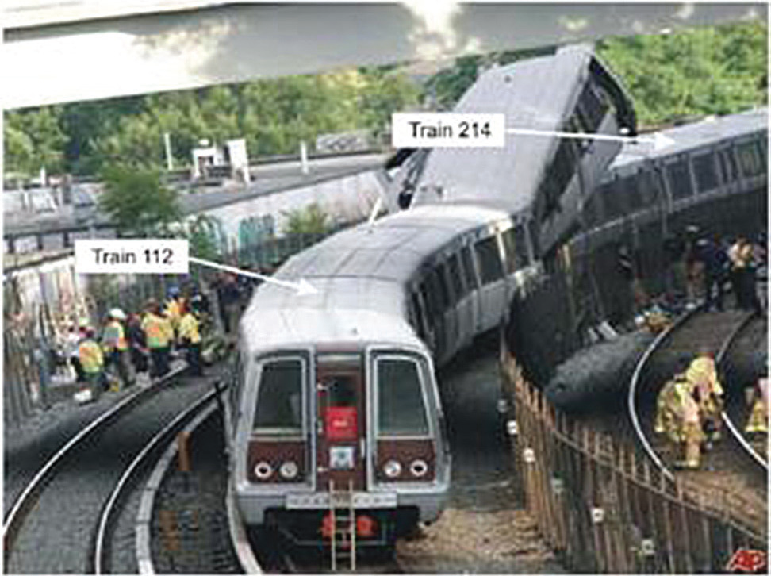
Case Study: Washington DC METRO collision
WMATA failed to replace or retrofit 1000-series railcars, which were shown in a 2004 accident to exhibit poor crashworthiness.
WMATA failed to institutionalize and employ across the system an enhanced track circuit verification test procedure that was developed following a near collision in 2005.

Slide 33
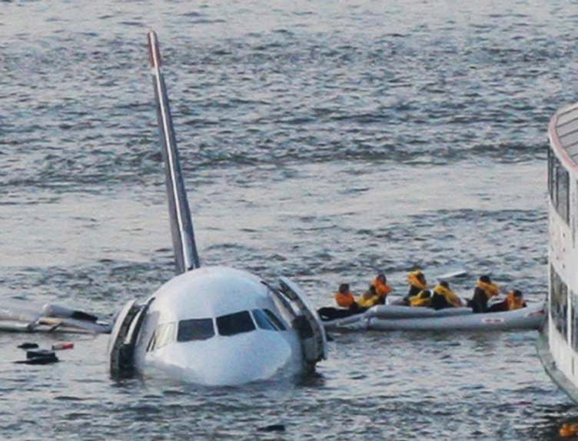
Case Study: US Airways – Forced Landing on Hudson River
The story of US Airways flight 1549 contains the same threads of leadership, training, planning and preparation required for any corporation to be sufficiently able to respond when a crisis strikes. This incident reinforces the importance of promoting a positive safety culture by demonstrating how the strong safety culture traits aided the crew in protecting the safety of the passengers.

Slide 34
Final Thoughts
Concept of safety culture spans across industries and countries
Safety culture has contributed to many well known events (historical & current)
Field is evolving
NRC continuing education and outreach efforts
Encourage States to continue education and outreach efforts
34

Slide 35
State Education and Outreach Efforts
Raise safety culture during inspection entrance and exit meetings
Provide information on State websites or through mailings
Presentations during State Regulatory Conferences
Make use of NRC’s educational tools
35

Slide 36
Resources
  Educational Tools
  Brochures (English and Spanish)
  Revisable electronic brochure
  Case Studies/User Guide
  Posters
  Pop-ups
  Presentation template and talking points
  NRC safety culture website: http://www.nrc.gov/about-nrc/regulatory/enforcement/safety-culture.html
cindy.flannery@nrc.gov or (301) 415-0223
june.cai@nrc.gov or (301) 415-5192

Slide 37
