Slide 1
Safety Culture
Policy Statement
Template
The following presentation slides and talking points are intended for Agreement States to use in communicating about safety culture to their licensees and can be tailored based on the State’s specific needs.
Slides 19-27 contain additional supporting information and can be included as appropriate, depending on the length of time available for the presentation and interest of the audience.

Slide 2
Presentation Overview
What is Safety Culture?
Why is Safety Culture Important?
Safety Culture Policy Statement
  Background/development
  Policy Statement elements
  Case studies (optional)
Notes:
This presentation will provide some general background information about the field of safety culture, including what it is about and why it is important.
This presentation also contains some of the history that led to the development of the Safety Culture Policy Statement that was finalized in June 2011, followed by the key elements of the policy statement. [Optional: provide State’s position on the Policy Statement].
Optional:
This presentation will also include several case study examples from other industries and recent well known events, that have pointed to weaknesses in safety culture as root or contributing causes, and one where a strong safety culture contributed to a positive outcome.

Slide 3
What is Safety Culture?
Safety culture is the extent to which safety is emphasized, both formally and informally, by an organization and its members
Safety culture is not separate or distinct from organizational culture
Rather, “safety” is a goal that may sometimes compete with an organization’s primary mission
Notes:
The term “safety culture” appears to have been first used after the Chernobyl nuclear plant disaster in 1986. The investigation report by the International Atomic Energy Agency (IAEA) pinpointed “deficient safety culture" as one of the contributing factors (see page 23 of report at http://www-pub.iaea.org/MTCD/publications/PDF/Pub913e_web.pdf). From then on, the concept of safety culture has been used more and more in safety research, particularly in high-risk industries such as nuclear, petrochemical, and public mass transportation (railway, aviation), recognizing the importance of the human element in accident and risk prevention.
Safety culture is generally considered to be a specific aspect of organizational culture -- the organization’s shared beliefs, values, and attitudes that contribute to ensuring safe operations.
Organizational culture is often described as “the way we do things around here.”
Optional: [State name] defines safety culture as “…” (if applicable).
The U.S. Nuclear Regulatory Commission’s (NRC) formal definition will be discussed later in the presentation.

Slide 4
Culture Resolves Goal Conflicts
Every organization must resolve conflicts between sometimes competing goals, e.g., cost vs. schedule and safety vs. quality
The organization’s members (groups and individuals) face daily goal conflicts in performing their jobs
  Make local choices among competing goals
  Take actions that demonstrate goal-conflict resolution
The organization’s culture includes guidance for resolving conflicts between goals
4
Notes:
In each organization, there are competing goals that occur at every level of the organization. There may be conflicting demands from a cost and schedule standpoint, versus safety and quality.
The organization, and its members, may face these competing goals on a daily basis. These decisions may occur at all levels of the organization, not just at the top. Each worker may encounter his/her version of these conflicts and need to make decisions at the local level to resolve them.
The organization’s culture (both the intended as well as the unintended aspects) plays a role in guiding an individual’s decision. The person has to weigh what he/she views the organization is prioritizing as important (safety? production?).

Slide 5
Occupational Safety vs.
Safety Culture
Goal of occupational safety: provide a workplace free from recognized hazards to safety and health, such as exposure to toxic chemicals or excessive noise
Goal for an organization to develop a positive safety culture: encourage the development of values and behaviors that support the safe and secure use of nuclear materials
Notes:
Sometimes there is confusion regarding the difference between occupational safety and safety culture.
Point of clarification:
The goal of occupational safety and health programs is to foster a safe and healthy work environment - work conditions that are free of known dangers.
As applied to the nuclear industry, the goal of safety culture is to encourage values and behaviors that support the safe and secure use of nuclear materials.

Slide 6
Why Do We Care?
Safety culture affects safety performance
  Injury rates
  Accident rates
  Patient safety
Results supported across industries
  Aerospace, healthcare, manufacturing, construction, agriculture, off-shore oil and gas, highway safety, aviation
Notes:
Sources of evidence that show safety culture affects safety performance:
Case studies and root cause analyses of accidents and events.
Intervention studies where safety performance improved after the culture was changed.
Survey research that demonstrated that changes in culture were leading indicators of safety performance.

Slide 7

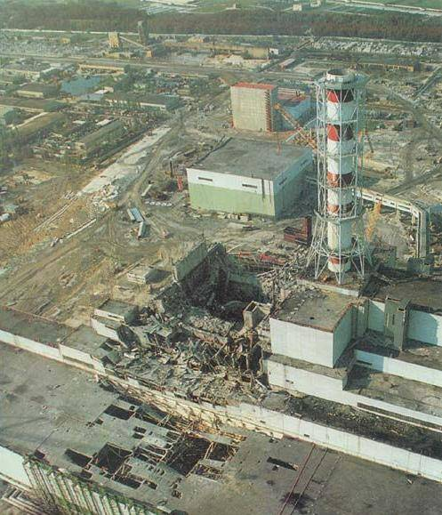
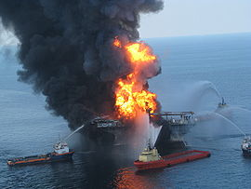
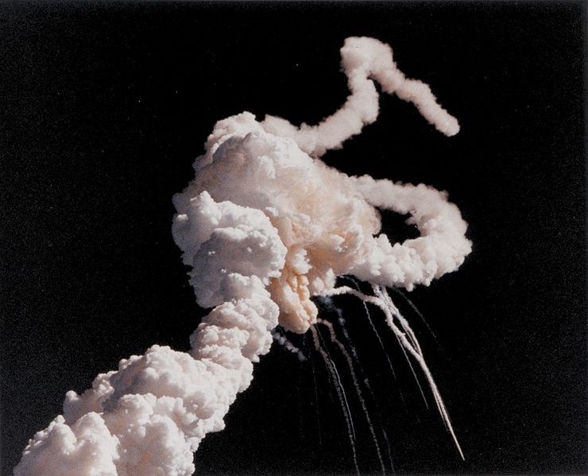
Safety Culture Examples
Chernobyl
Challenger
Columbia
Deepwater Horizon
Notes:
Research found support for the connection between safety culture and performance across many industries. Several well known events have pointed to weaknesses in elements related to safety culture as contributors.
Here are a few examples.
Chernobyl (1986) – International Atomic Energy Agency (IAEA) report, INSAG-7, stated, “The accident can be said to have flowed from deficient safety culture, not only at the Chernobyl plant, but throughout the Soviet design, operating and regulatory organizations for nuclear power that existed at the time” (http://www-pub.iaea.org/MTCD/publications/PDF/Pub913e_web.pdf, page 23).
Challenger (1986) – Report of the Presidential Commission on the Space Shuttle Challenger Accident stated, “…there was a serious flaw in the decision making process leading up to the launch…both NASA and contractor management first failed to recognize [the faulty design of its joint] as a problem, then failed to fix it and finally treated it as an acceptable flight risk” (http://science.ksc.nasa.gov/shuttle/missions/51-l/docs/rogers-commission/table-of-contents.html, chapter 5).
Columbia (2003) – The accident investigation board found a “broken safety culture” at NASA. Board concluded the accident was “…rooted in the Space Shuttle Program’s history and culture” (http://anon.nasa-global.speedera.net/anon.nasa-global/CAIB/CAIB_lowres_full.pdf, page 184).
Deepwater Horizon (2010) – US Coast Guard’s investigation stated, “Deepwater Horizon and its owner, Transocean, have had serious safety management system failures and a poor safety culture” (http://www.uscg.mil/hq/cg5/cg545/dw/exhib/DWH%20ROI%20-%20USCG%20-%20April%2022,%202011.pdf, page 111).
Optional – additional slide and talking points that goes into more detail about the safety culture issues involved with Columbia can be found in the supplemental information section.

Slide 8
Optional Slide: Overview of State’s program/agency
Provide information about State’s program

Slide 9
Optional Slide: State’s Position on Safety Culture Policy Statement
Provide State’s Position on Safety Culture Policy Statement

Slide 10
Why is Safety Culture Important to [State name]?
Operating experience has demonstrated nexus between safety culture and events
Safety culture contributes to the safe and secure use of radioactive materials
[State name] recognizes that licensees bear the primary responsibility for the safe and secure use of nuclear materials, while the [State name], as the regulator, must consider the importance of safety culture in its oversight programs
Notes:
The importance of a positive safety culture has been demonstrated by a number of significant, high-visibility events involving nuclear materials over the last 20 years. Weaknesses in safety culture were identified as root causes or contributing causes in many of these events.
NRC recognized that organizational factors have the potential to contribute to accidents well before the term “safety culture” was introduced. NRC’s investigation of the Three Mile Island (TMI) accident in 1979, for example, identified management problems, not hardware problems, as one of the principal deficiencies in commercial reactor safety.
There are links between safety culture and safety performance.
Examples by NRC licensees include loss of control of sealed sources, prostate radioactive seed therapy performed without evaluating seed placement, and years of undetected boric acid corrosion in the reactor pressure vessel head at the Davis-Besse Nuclear Power Station (2002). The Davis Besse event led to the NRC to enhance their reactor inspection and oversight program to better address safety culture.
Optional: provide applicable State examples.
Because weaknesses in safety culture or a deteriorating safety culture appear to increase the likelihood of performance problems and the consequences of those problems, both the NRC and [State name] consider safety culture in our oversight activities.

Slide 11
Safety Culture
Policy Statement
Effective June 14, 2011
Includes safety culture definition and nine traits
Applies to all regulated entities
Does not address implementation directly
U.S. Nuclear Regulatory Commission (NRC) and Agreement States are continuing to engage in activities to increase awareness and understanding of the benefits of a positive safety culture
Notes:
Expanding on the work that was done in the reactor area, in February 2008, the Commission directed NRC staff to expand the policy on safety culture to address the unique aspects of security and ensure that the policy was applicable to all licensees and certificate holders. The Commission also directed the staff to increase attention to safety culture in the materials area.
Over the course of the three-year development period until the time that it was finalized in June 2011, the NRC staff held a series of public meetings and workshops with stakeholders to inform the development of the policy statement and gather a broad spectrum of views on safety culture terminology and the traits that comprise the safety culture concept. The Organization of Agreement States actively participated throughout the development process.
The Safety Culture Policy Statement recognizes the diversity of the regulated entities. It applies to all regulated entities including reactors, the many and diverse materials users, fuel facilities, spent fuel shipping and storage cask vendors -- essentially all licensees and certificate holders.
The policy statement addresses what is important in a positive safety culture, but does not address how licensees should implement the policy statement’s expectations of safety culture in their organization.
Throughout this initiative, the overriding direction from the Commission has been to educate and inform the regulated community about the importance of developing and maintaining a positive safety culture. The NRC staff and Agreement State partners have done that by developing educational tools and by continuing to speak at various stakeholder forums and industry conferences.

Slide 12
Statement of Policy
Sets forth the Commission’s expectation that individuals and organizations performing regulated activities establish and maintain a positive safety culture commensurate with the safety and security significance of their actions and the nature and complexity of their organizations and functions
Notes:
The next few slides will provide the key elements of the policy statement.
A policy statement is a tool used to communicate with licensees and other stakeholders about matters that are important to the NRC.
Policy statements are not regulations or requirements.
The safety culture policy statement is an expectation; it does not contain requirements that must be implemented.
So, in this regard
Licensees have the primary responsibility for safety culture at their facilities.
Licensees are to do what they deem appropriate for the scope of their program.
Safety culture must be tailored to the organization.
It is up to the organization to determine how to apply the policy statement.

Slide 13
Safety Culture Definition
Nuclear Safety Culture is the core values and behaviors resulting from a collective commitment by leaders and individuals to emphasize safety over competing goals to ensure protection of people and the environment.
Safety Culture Policy Statement
Notes:
The policy statement defines “safety culture” as provided in this slide.
“Nuclear” was added to “safety culture” because some stakeholders felt that it was important to capture the idea that nuclear is different. Definition reflects input and alignment among diverse range of participants during development process.
It’s interesting to note that the definition is only 32 words. The goal was to make it simple and a definition that everyone can understand.

Slide 14
Safety Culture Traits
  Experience has shown that certain personal and organizational traits are present in a positive safety culture
  A trait is a pattern of thinking, feeling, and behaving that emphasizes safety, particularly in goal conflict situations, such as:
    Production vs. safety
    Schedule vs. safety
    Cost of the effort vs. safety
Notes:
The Policy Statement describes how certain personal and organizational traits are present in a positive safety culture.
A trait is a pattern of thinking, feeling, and behaving that emphasizes safety. This is particularly the case in situations where organizational goals are actually, or perceived to be, in conflict, such as:
Production vs. safety – “adding these safety controls will impact our production quotas;”
Schedule vs. safety – “we can’t afford the time to do it right; we’ll miss our deadline;” and
Cost of the effort vs. safety – “the safety controls cost too much.”
A positive safety culture is often described as having a “safety-first focus.” Characteristics of a positive safety culture include: valuing safety over other competing goals, such as production; conservative decision-making; maintaining a questioning attitude; and problem identification and resolution.
You can think of safety culture as what “someone is doing when no one is looking.”

Slide 15
Safety Culture Traits
Leadership Safety Values and Actions | Problem Identification and Resolution | Personal Accountability
Leaders demonstrate a commitment to safety in their decisions and behaviors | Issues potentially impacting safety are promptly identified, fully evaluated, and promptly addressed and corrected commensurate with their significance | All individuals take personal responsibility for safety
Work Processes | Continuous Learning | Environment for Raising Concerns
The process of planning and controlling work activities is implemented so that safety is maintained | Opportunities to learn about ways to ensure safety are sought out and implemented | A safety conscious work environment is maintained where personnel feel free to raise safety concerns without fear of retaliation, intimidation, harassment or discrimination
Effective Safety Communications | Respectful Work Environment | Questioning Attitude
Communications maintain a focus on safety | Trust and respect permeate the organization | Individuals avoid complacency and continually challenge existing conditions and activities in order to identify discrepancies that might result in error or inappropriate action
Notes:
The policy statement contains nine traits that are important to a positive safety culture.
They are in no particular order, other than placing “Leadership Values” first, as it is important for leadership to value safety in order for it to be effective.
There may be traits not included in the Policy Statement, that are also important to a specific organization in maintaining a positive safety culture.

Slide 16
What Does Safety Culture
Look Like for You?
Optional: provide examples of how traits are demonstrated in practice for the audience’s industry, such as:
  Policies supporting safety culture and/or raising safety concerns
  Procedures for identifying, evaluating, and correcting issues
  Use of error reducing techniques
  Metrics focused on safety and quality vs. cost and production
  Training and knowledge management processes
  Safety communications messages
Note: these examples are being provided for illustrative purposes only. Specific practices will vary by industry and by organization.
This may be one of the most important slides in the presentation. Encourage providing high quality examples to demonstrate how safety culture translates into practice for the audience’s industry.
Notes:
Encourage audience to think about safety culture in the context of their own organizations.
What does safety culture mean to them?
What does it look like in their organization (e.g., policies, procedures, attitudes, behaviors, etc.)?
How is safety being communicated and demonstrated as a priority (or is it)?
Conditions that could potentially signal a weak safety culture include:
A management team that stresses productivity over safety.
A maintenance department that allows backlogs to add up.
Supervisors who do not provide adequate oversight of safety-significant actions.
Employees who proceed even when uncertain and do not raise concerns.

Slide 17
Final Thoughts
Concept of safety culture spans across industries and countries
Safety culture has contributed to many well known events (historical & current)
Field is evolving
NRC and Agreement States continuing education and outreach efforts
17
Notes:
Safety culture is not limited to the nuclear industry. It is being discussed in an increasing number of sectors.
The fields of safety culture and organizational culture are evolving, and we continue to learn more, both from positive and negative outcomes. There has been growing interest from all types of industries and organizations and an increase in sharing across specialties.
In conclusion, safety culture is a continuous journey. It is a living, evolving concept. It is not an end goal that can be checked off, or something static. It is always changing, and a positive safety culture is implemented differently by different organizations.
Encourage audience to view the details through their “safety culture lens” and consider how elements of safety culture applied or played a role, as they read more about the events discussed in this presentation and others that may be happening in the news in the upcoming months.
Encourage audience to move forward together with collective efforts to enhance safety culture. Share insights on how to establish and maintain a positive safety culture and to work with each other, their safety managers, and other organizations in educating and engaging on safety culture. In this way, we will facilitate a “safety first” focus and our shared commitment to safety.
End with the following quote from NRC Chairman Macfarlane, in a speech she made on Sept 17, 2012, related to the Fukushima accident and safety culture: “there are many lessons that we must all take away from the accident at Fukushima, but some of the most valuable extend beyond the technical aspects and are embedded in human and organizational behaviors. Among these is safety culture. I commend the courage of our Japanese colleagues in demonstrating critical self-reflection and transparency so that all nations can benefit from their experiences. By continuing to discuss the organizational learning engaged in by the operators to enhance safety culture principles, we will all benefit from the insights gained and be able to apply them to our own operations” (http://pbadupws.nrc.gov/docs/ML1226/ML12261A373.pdf).
Optional: add in any State specific quotes or additional thoughts.

Slide 18
Resources
  NRC safety culture website: http://www.nrc.gov/about-nrc/regulatory/enforcement/safety-culture.html
  Educational Tools
  Brochures (English and Spanish)
  Case studies/user guide
  Posters
  Pop-ups
  State Contact Information
  NRC contacts:
  Cindy Flannery cindy.flannery@nrc.gov or (301) 415-0223
  June Cai june.cai@nrc.gov or (301) 415-5192
  Division of Intergovernmental Liaison and Rulemaking
  Office of Federal and State Materials and Environmental Management Programs
Notes:
The tools NRC has developed to facilitate safety culture outreach are listed on this slide.
Except for the pop-ups, they are also available on the website.

Slide 19
Optional slides – additional information about organizational culture

Slide 20
Organizational Culture – in Edgar Schein’s terms …
“A pattern of shared basic assumptions that was learned by a group as it solved its problems of external adaptation and internal integration, that has worked well enough to be considered valid and, therefore, to be taught to new members as the correct way you perceive, think, and feel in relation to those problems.”
A combination of the intended (the formal organization) and the unintended (the informal organization)
20
Notes:
Edgar Schein, a former professor at the Massachusetts Institute of Technology, was the first to put the concept of “organizational culture” on the map in the 1980’s.
Here is a quote from him that describes the concept of organizational culture. Highlight a couple of important points from this statement. “A pattern of shared assumptions…that has worked well enough to be considered valid…and taught to new members as the correct way…” This is a very important point. Some have described organizational culture as the “residue of success.” What has worked in the past is passed on to an organization’s new members.
Culture includes our values (what’s really important to the organization) and the norms (how we do things around here).
It’s important to note that organizational culture can be a combination of the intended (i.e., what the organization formally has in place and states its values and beliefs are) as well as the unintended (i.e., how things are really done). Most of the time those can be in agreement, but other times they may not.
Reference: Schein, Organizational Culture & Leadership, 1992.

Slide 21
Subcultures
Develop in larger organizations
May arise from work-related factors, but also geography or affinity groups
May be more powerful than overall organizational culture
May be inconsistent with some aspects of overall culture
21
Notes:
What is the importance of subcultures? In large organizations, culture may not be uniform across all groups. Different organizational units may develop their own cultures, which sometimes could be different than the culture of the larger organization.
Some of the factors that could cause these differences could due to variations in type of work/profession, geography, demographics, etc.
Sometimes subcultures can be a more powerful influence than the overall organizational culture. Consider a large, international organization. In some cases, the local culture could have more influence on a unit in the organization, than the overall organizational culture.
It’s also possible that the culture at the local level may conflict or be inconsistent with the organization’s broader culture.

Slide 22
Optional slides – case study examples

Slide 23
NASA’s Space Shuttle Columbia
“Broken safety culture” at NASA
  Ineffective communication
  Inadequate concern over deviations from expected performance
  Silent safety program
  Schedule pressure
Notes:
NASA’s space shuttle Columbia broke apart on February 1, 2003 as it returned to Earth from a 16-day mission. All 7 astronauts were killed. NASA created the Columbia Accident Investigation Board to investigate the accident. The Board presented its view that, in additional to technical failures, NASA’s organizational culture contributed just as much to the accident.
The report states that “organizational culture is a powerful force that can persist through reorganizations and the change of key personnel. It can be a positive or a negative force.”
In the report, safety culture refers to an organization’s characteristics and attitudes – promoted by its leaders and internalized by its members – that serve to make safety the top priority.
The board found that there was a “broken safety culture” at NASA.
There was a pattern of ineffective communication, leaving risks improperly defined, problems unreported, and concerns unexpressed. The Board believed that deficiencies in communication were a foundation for the Columbia accident. The system for reporting safety problems was too cumbersome and time-consuming. There was an absence of authority in two key program areas responsible for integrating information across all programs and elements in the Shuttle program.
The Board witnessed a consistent lack of concern about the debris strike on Columbia. NASA managers told the Board “there was no safety-of-flight issue” and “we couldn’t have done anything about it anyway.”
NASA had a culture that had gradually begun to accept escalating risk, and a safety program that was largely silent and ineffective.
Regarding organizational causes, the Board concluded the accident was “…rooted in the Space Shuttle Program’s history and culture.” Cultural traits and organizational practices detrimental to safety were allowed to develop, including: reliance on past successes as a substitute for sound engineering practices; organizational barriers that prevented effective communication of critical safety information and stifled professional differences of opinion; lack of integrated management across program elements; and the evolution of an informal chain of command and decision-making processes that operated outside the organization’s rules.
Report link: http://anon.nasa-global.speedera.net/anon.nasa-global/CAIB/CAIB_lowres_full.pdf

Slide 24
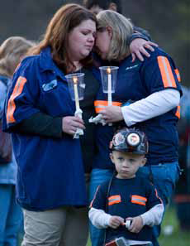
Case Study:
April 2010 Upper Big Branch Mine Explosion
Existing government reports suggest that Performance Coal Company/Massey “promoted and enforced a workplace culture that valued production over safety including practices calculated to allow it to conduct mining operations in violation of the law.”
“While violations of particular safety standards led to the conditions that caused the explosion, the unlawful policies and practices implemented by employer were the root cause of this tragedy.”
Notes:
In April, 2010, a series of explosions occurred inside the Upper Big Branch mine in southern West Virginia. Twenty-nine coal miners lost their lives in the “largest coal mine disaster in the U.S. in 40 years.”
The company has a documented pre-existing history of poor safety performance. They failed to report accident data accurately -- they had twice as many accidents as the operator reported.
The case study lists many violations of regulatory safety standards. The flagrant safety violations contributed to a coal dust explosion, but the employer was found directly responsible for the blast.
The regulatory authority was also found to be at fault for failing to take action even after the employer was found to have multiple safety violations at the Upper Big Branch mine in 2009.
This case study provides examples of weaknesses in each of nine Safety Culture Policy Statement traits. A repeated theme was the fear of retaliation by the employees and a culture of intimidation by management.
Announced in December: Record $210 million settlement. Cited: “Culture of fear and intimidation” and the employer promoting a workplace culture that “valued production over safety.”
Case study link: http://pbadupws.nrc.gov/docs/ML1206/ML12069A003.pdf.

Slide 25
“Lessons Learned” from
Upper Big Branch Mine Explosion
  Senior Management dictates the tone for the balance between safety and corporate performance
  No single event led to this catastrophe -- it resulted from a series of events that were precipitated by a weak safety culture which included the absence of a safety conscious work environment
Notes:
These two items (safety and corporate performance) are not mutually exclusive and can and must successfully coexist. Linkages between safety culture and performance were discussed earlier in the presentation. A strong safety culture demands a safety first focus approach to business.

Slide 26
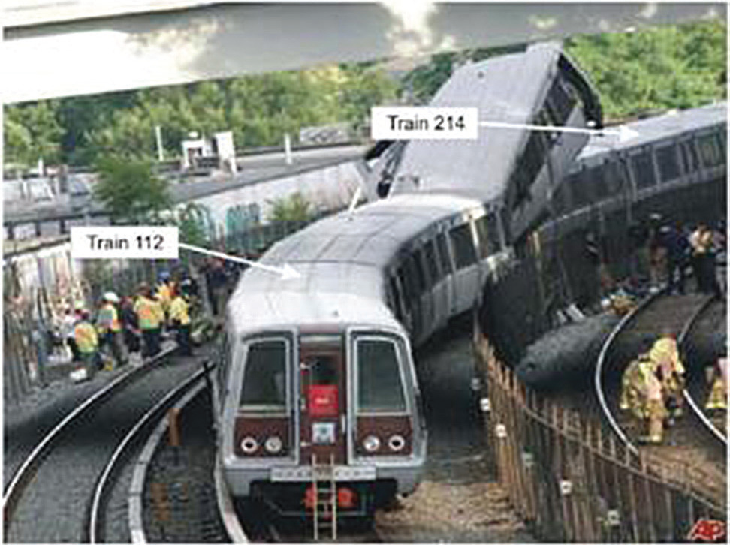
Case Study:
June 2009 Washington DC
METRO collision
Washington Metropolitan Area Transit Authority (WMATA) failed to replace or retrofit 1000-series railcars, which were shown in a 2004 accident to exhibit poor crashworthiness
WMATA failed to institutionalize and employ across the system an enhanced track circuit verification test procedure that was developed following a near collision in 2005
Lack of safety culture – contributing cause
Notes:
In June, 2009, during the evening rush hour, a Metrorail train struck the rear of a stopped Metrorail train. The powerful impact caused the rear car of the stopped train to telescope into the lead car of the moving train, resulting in a loss of occupant survival space in the lead car of about 63 feet (about 84 % of its total length). Nine people aboard the moving train, including the train operator, were killed. Emergency response agencies transported 52 people to local hospitals.
Three of the safety culture traits in this event included:
(1) Problem Identification and Resolution: In 2006, the National Transportation Safety Board (NTSB) recommended that WMATA accelerate the retirement of all 1000-series railcars, and replace them as soon as possible with cars that have crash worthiness collision protection at least comparable to the 6000-series railcars. This issue was identified and evaluated but not addressed or corrected commensurate with the potential risk.
(2) Environment for raising concerns: The NTSB found examples of a deficient reporting culture within WMATA resulting from fear of retaliation.
(3) Continuous learning and effective safety communication: WMATA developed an enhanced track circuit verification test to identify track circuits with the potential to lose train detection; however, the test was never institutionalized and circuit monitoring tools fell into disuse, indicating that WMATA did not communicate that hazard to all departments of the agency. WMATA developed and issued technical bulletins requiring the use of an enhanced circuit verification test procedure; however, none of the WMATA technicians interviewed as part of the investigation was familiar with the enhanced procedure.
This accident reinforces the need for, and importance of, promoting a positive safety culture.
Case study link: http://pbadupws.nrc.gov/docs/ML1115/ML11159A220.pdf.

Slide 27
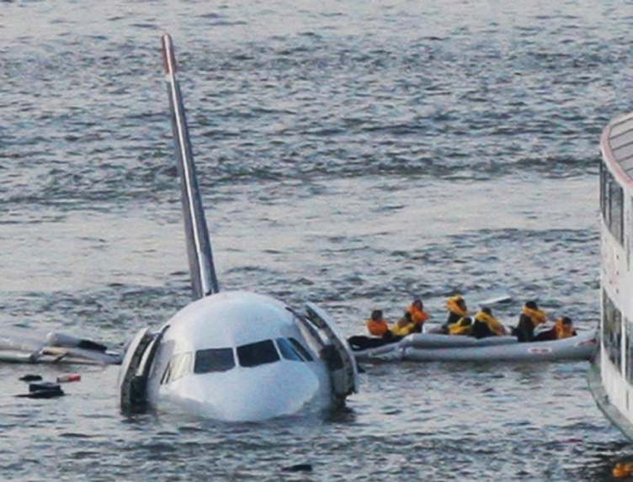
Case Study:
Jan 2009 US Airways –
Forced Landing on Hudson River
Lose of both engines due to bird strike
Captain landed plane on Hudson River – all 155 passengers and crew evacuated safely
Incident reinforces the importance of promoting a positive safety culture
  Strong safety culture traits aided the crew in protecting the safety of the passengers
  Contribution to successful outcome included leadership, training, and planning and preparation
Notes:
On January 15, 2009, US Airways Flight 1549 departed LaGuardia Airport and less than 2 minutes after takeoff, the captain told the control tower there was an emergency. There were bird strikes in both engines. With both engines dead, the captain started the auxiliary power unit and took control of the aircraft. Initially, he informed the control tower of his intent to return to LaGuardia; however, he was unable to return to the runway and informed the controller that he had no other alternative but to land on the Hudson River. The plane started quickly losing altitude and the captain glided the aircraft, tail first, into the Hudson River. Although the airplane was substantially damaged, all 155 passengers and crew evacuated safely.
Safety culture traits in this event included:
Leadership Safety Values and Actions: Even after the successful landing on the Hudson River, the captain’s commitment to the safety of others was evident. Before leaving the cabin, he walked up and down the aisle twice to make sure everyone was out. Once he was out of the cabin, he instructed the rescue boats to take care of the people on the wings first because those in the rafts were already safe. His commitment to the safety of others before thinking of himself is a reflection of his strong leadership skills.
Continuous Learning/Training: In order to ensure safety, US Airways Crew Resource Management and Threat Error Management training had been integrated into all aspects of the US Airways mandatory training plan. The captain stated that the training gave them the skills and tools needed to build a team quickly, open lines of communication, share common goals and work together.
This event provides an example where a positive safety culture contributed to a safe outcome when an unplanned sequence of events was set in place and put the safety of the passengers and crew in danger.
Case study link: http://pbadupws.nrc.gov/docs/ML1122/ML11228A218.pdf.

